Slide 1
TEAM ECOVOLVE
PORTABLE SOLAR CHARGER

Slide 2
DESIGN THINKING
PROJECT
CONSERVATION OF ENERGY
(USE OF RENEWABLE ENERGY SOURCES)

Slide 3
TEAM MEMBERS
SHUBH(CS84-80) ~~ 202401120069@mitaoe.ac.in
RISHI PATEL(CS84-79) ~~ 202401120070@mitaoe.ac.
MADINA MULANI(CS84-70) ~ 202401120072@mitaoe.ac.in
SINDHUJA RAINA(CS84-81) ~~ 202401120014@mitaoe.ac.in

Slide 4
PORTABLE SOLAR CHARGER
SECONDARY RESEARCH

Slide 5
INTRODUCTION
Electrical devices and gadgets have become integral to modern life, revolutionizing the way we communicate, work, and entertain ourselves. They enhance productivity through tools like laptops and smartphones, enabling seamless connectivity and access to information anytime, anywhere. In addition, smart home devices improve convenience and energy efficiency, allowing users to manage their environments with ease.
People often encounter several common problems related to charging their devices. Here are some of the most frequent issues:
Slow Charging: Many users experience slower charging times due to inadequate chargers or cables that don’t support fast charging.
Incompatibility: Different devices often require specific chargers, and using the wrong one can lead to ineffective charging or even damage.
Overheating: Devices can overheat while charging, which can slow down the process or cause safety concerns.
Battery Degradation: Over time, batteries lose capacity, leading to shorter charging times and reduced performance.

Slide 6
Today’s people require chargers that are fast, versatile, and convenient, given the increasing dependence on electronic devices. The types of chargers that are most in demand include:
1. Fast Chargers (High-Wattage)
USB-C Power Delivery (PD): Many devices, including smartphones, tablets, and laptops, support fast charging via USB-C. These chargers offer higher wattage (up to 100W or more) for quicker charging times, especially for devices like laptops or large tablets.
2. Wireless Chargers
Qi-Compatible Chargers: Wireless charging is becoming standard, especially for smartphones, smartwatches, and earbuds. People prefer the convenience of just placing their devices on a pad without needing cables.
3. Portable Power Banks
High-Capacity Power Banks: Portable power banks with high capacities (10,000 mAh to 30,000 mAh) and fast charging capabilities are highly desirable for charging on the go, especially for travel and outdoor activities.
Solar-Powered Power Banks: For environmentally conscious users or those traveling in remote areas, solar-powered chargers are gaining popularity.

Slide 7
On the basis of surveys, we find out that people have mixed yet generally positive views about portable solar chargers. Here are some key perceptions:
Eco-Friendly Solution:
Many users appreciate portable solar chargers because they harness renewable energy, reducing reliance on traditional electricity sources. Environmentally conscious users see them as a step toward sustainability and lowering carbon footprints.
Great for Outdoor Activities:
Solar chargers are highly valued by outdoor enthusiasts, such as campers, hikers, and adventurers, who often need to charge devices in remote areas with no access to electrical outlets. These chargers provide a reliable way to keep phones, GPS devices, and other gadgets powered up.
Emergency Backup:
People consider solar chargers useful as emergency backups during power outages or natural disasters, especially when traditional charging methods aren’t available.
Portability and Convenience:
Many find portable solar chargers lightweight and easy to carry, which makes them convenient for travel or daily use. Some models come with foldable panels or are integrated into backpacks, making them even more accessible.

Slide 8
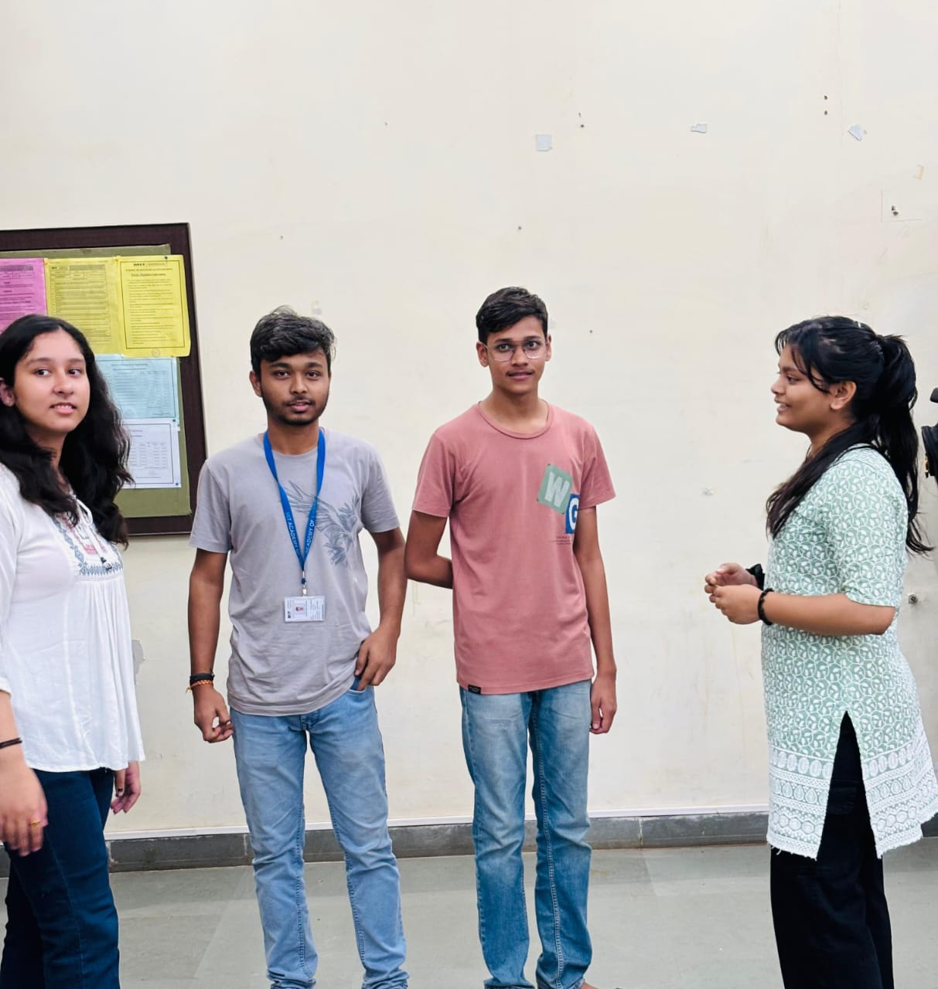
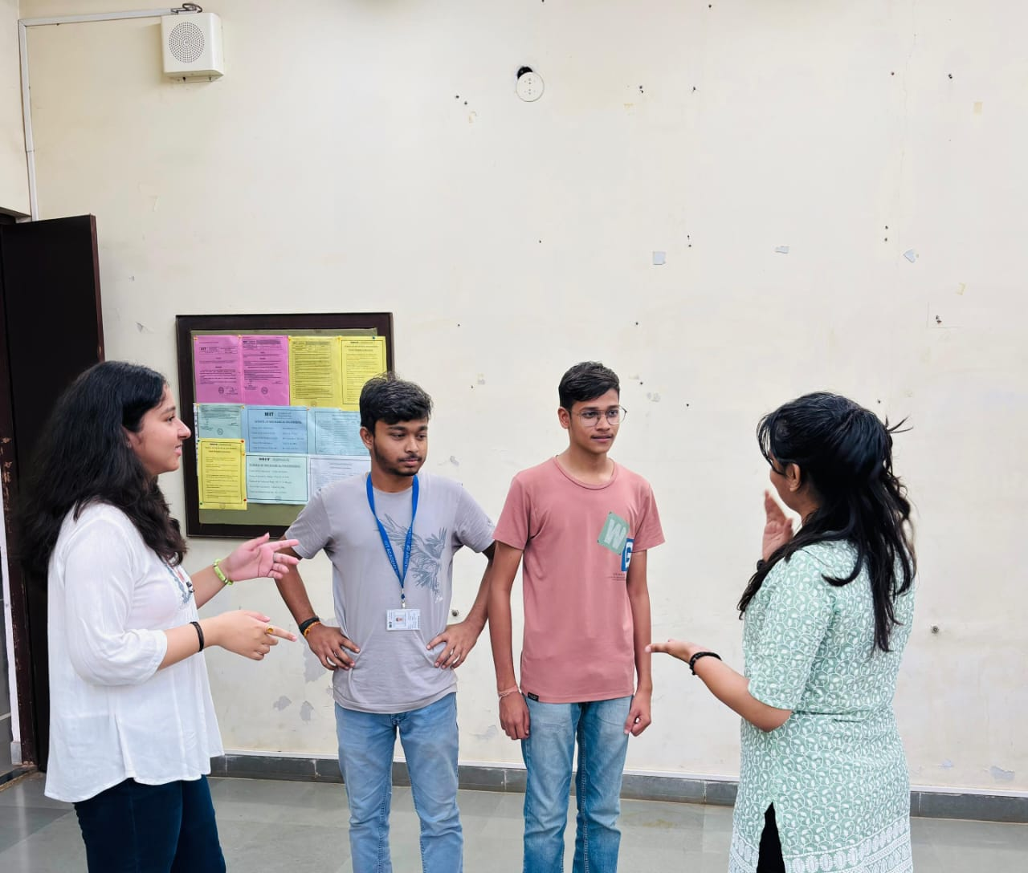
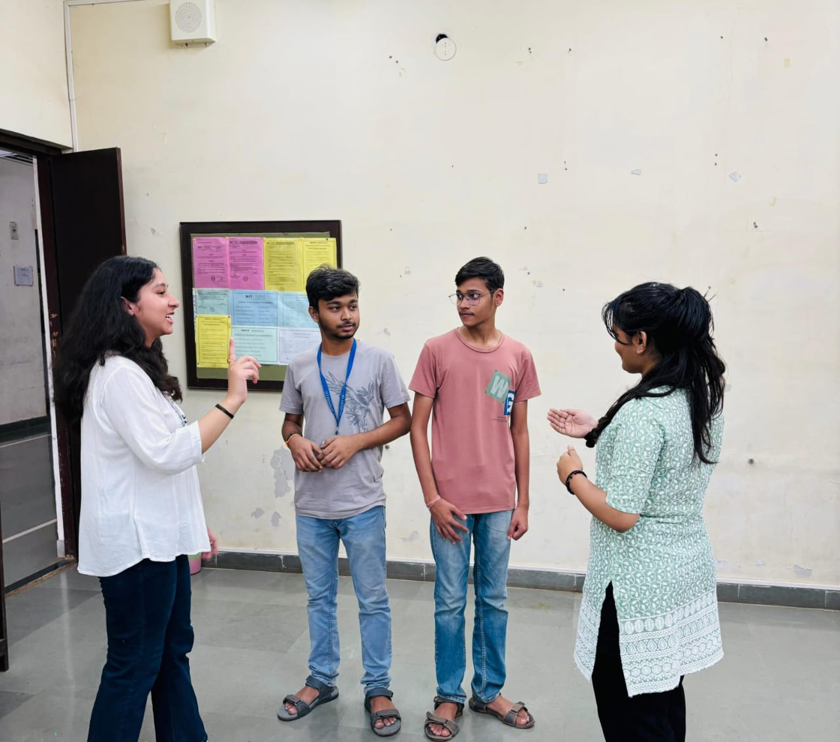

Slide 9
INSPIRATION FROM EXISTING SOLUTIONS
EXISTING SOLUTIONS:
Solar-Powered Power Banks: Power banks equipped with solar panels that can recharge via sunlight. They are popular for outdoor use, though they can be slower to recharge via solar than traditional power.
Example: BLAVOR Solar Charger, Anker Solar Power Bank.
Portable Solar Chargers: These chargers come equipped with solar panels and are used to power devices directly or store energy in built-in batteries. They are often designed for outdoor activities like camping or hiking.
Example: Goal Zero Nomad, BigBlue 28W Solar Charger.
Solar-Powered Charging Stations: Larger solar charging stations can be used for off-grid homes or remote locations, providing renewable energy for charging multiple devices.
Example: Jackery Solar Generator, EcoFlow Delta Max Solar Power Station.

Slide 10
INSPIRATION:
Products like the Goal Zero Nomad and BigBlue Solar Charger emphasize portability. They are designed to be lightweight, foldable, and easy to carry, making them ideal for outdoor enthusiasts.
We focus on designing a compact, modular solar charger that can be expanded or contracted based on user needs. For instance, create a charger with detachable solar panels that users can add or remove depending on the level of power they require. This could target travelers who need a lightweight option for short trips and more power for extended outings.
This would allow users to charge devices while commuting, cycling, or working in outdoor environments. Integrating solar panels into everyday accessories can appeal to students, professionals, and travelers.
We also focuses on using sensors or motors to tilt the panels toward the sun, maximizing efficiency throughout the day. This could be especially useful for camping, trekking, or off-grid locations where users may not always be able to manually adjust the solar panels.
When there’s no sunlight, users could generate power manually. This would cater to adventurers, campers, and those in disaster-prone areas.

Slide 11
VALIDATING ASSUMPTIONS:
Assumption: Many users assume that all chargers, regardless of type, should support fast charging and quickly charge their devices.
Reality: Not all chargers or devices support fast charging. Fast charging requires compatible technology on both the charger and the device.
Assumption : Many users assume that there devices should be charged all the time
Reality: Main concern is that their devices should stay connected rather than fully charged.
Assumption : Many users assume that solar chargers can only work in sunlight.
Reality: Solar chargers are effective in sunlight as well as in night depending upon battery efficiency.
Assumption: People tend to assume that solar chargers are only useful for outdoor activities or during emergencies when there’s no access to electricity.
Reality: Solar chargers can also be useful for daily use, such as charging devices at home or in the office, as a way to reduce electricity consumption or for eco-conscious users looking to leverage renewable energy more regularly.

Slide 12
Competitor Analysis:
FACTOR | WIRED CHARGERS | POWER BANK | SOLAR CHARGERS
Power Source | Wall outlet (AC power) | Pre-charged via outlet (AC power) | Sunlight (renewable energy)
Charging While Moving | No | Yes | Yes
Energy Storage | No | Yes | Yes
Sustainability | Low | Moderate | High
Environmental Impact | High | Moderate | Low
Reliability | Highly reliable | Reliable as long as pre-charged | Dependent on weather conditions and sunlight
Portability | Portable | Portable | Portable

Slide 13
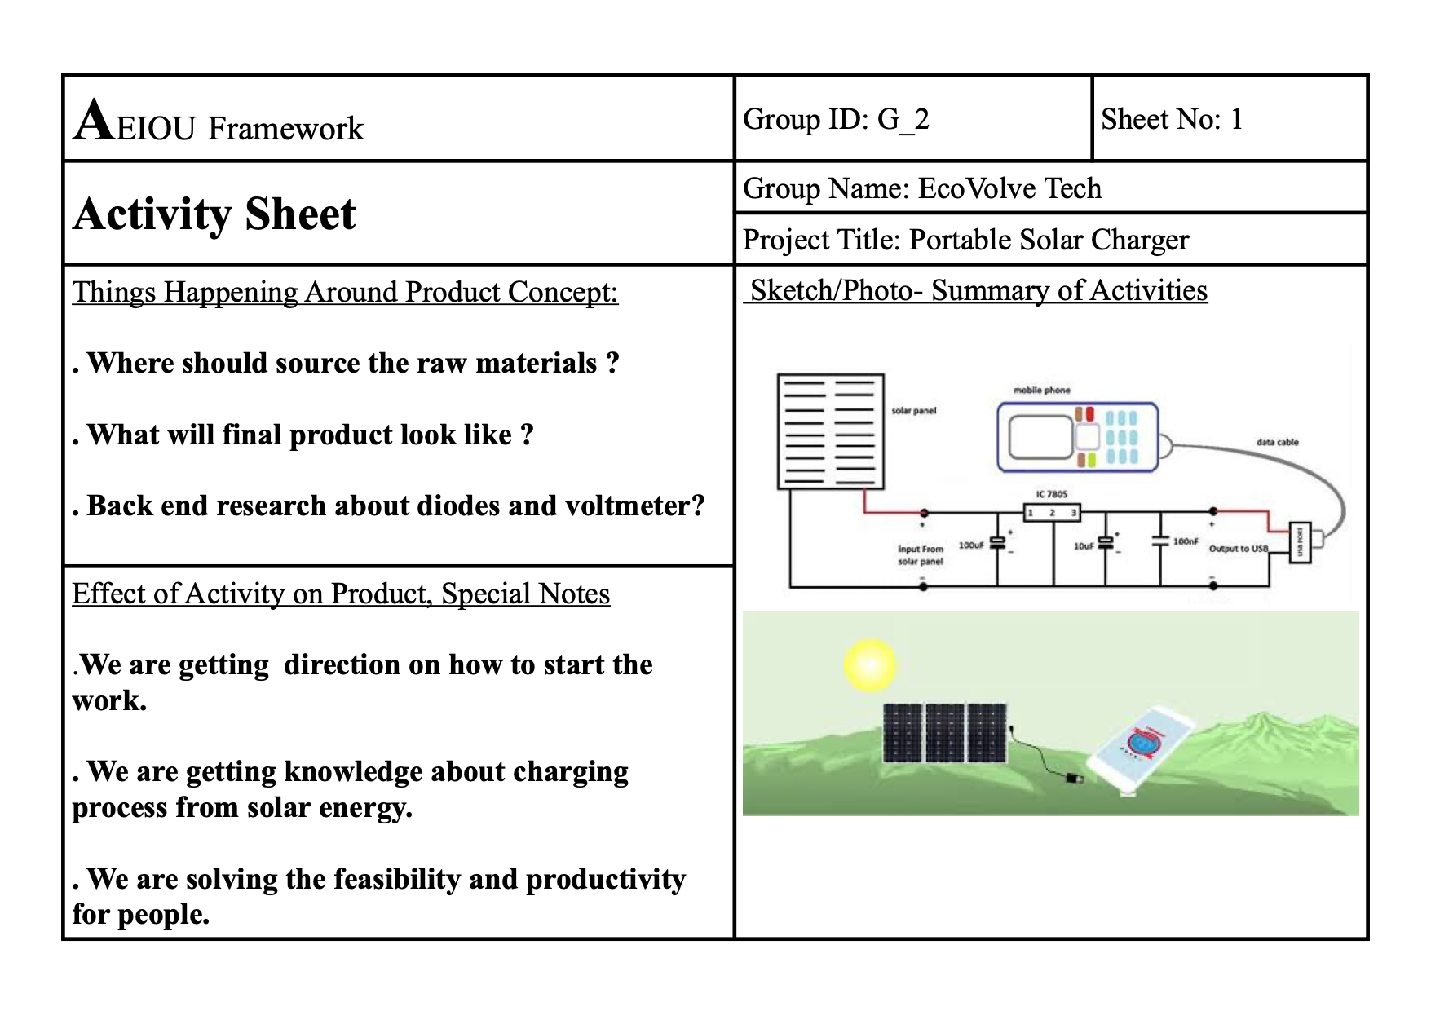
ACTIVITY SHEET

Slide 14
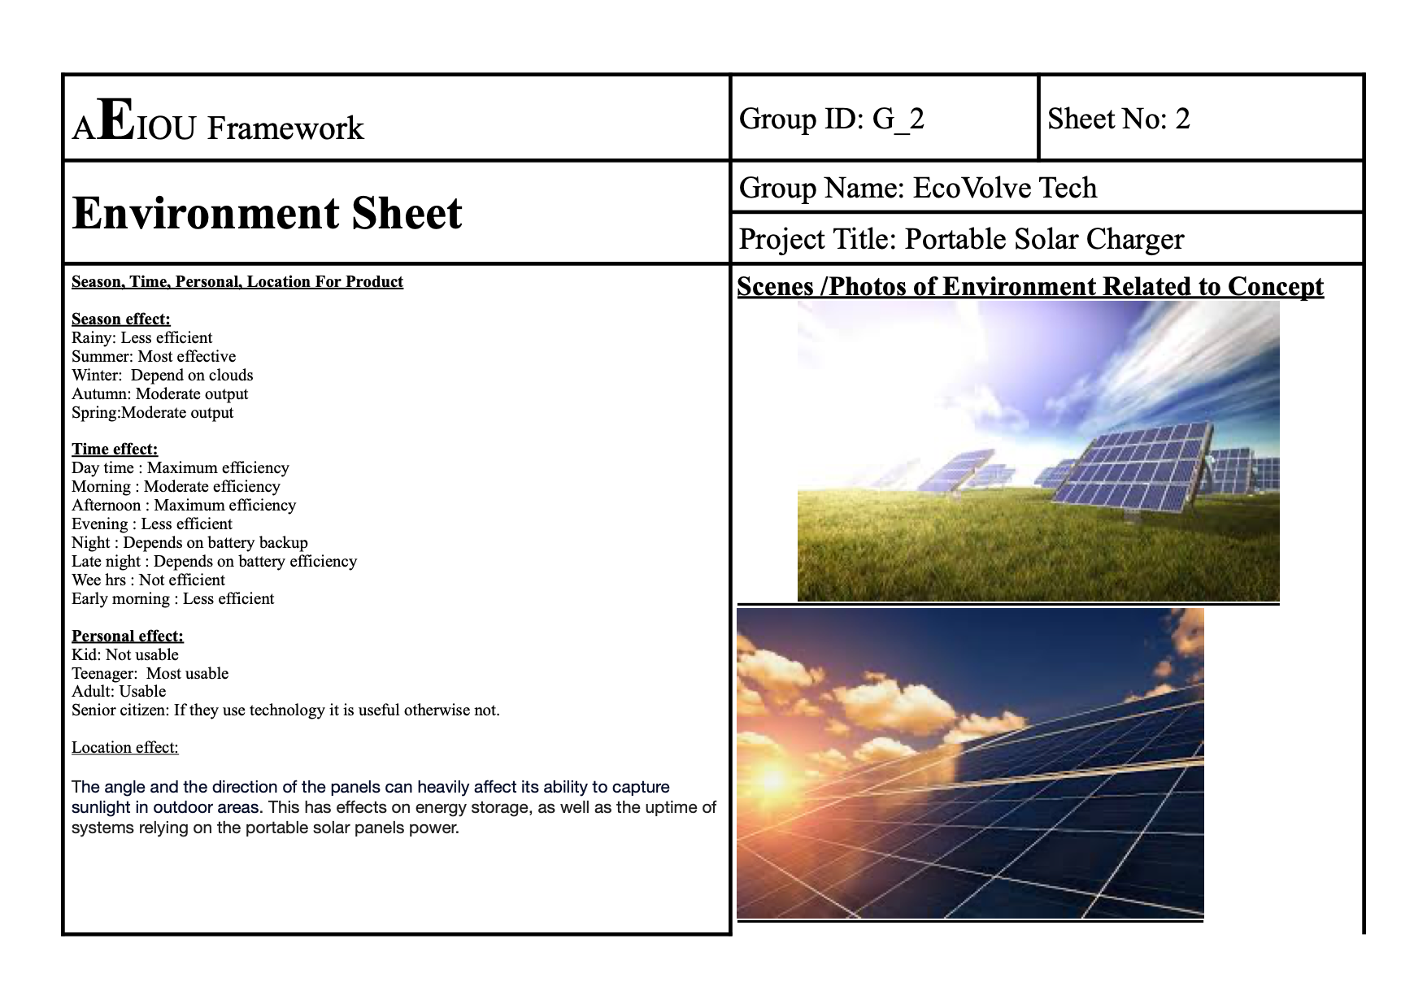
ENVIRONMENT SHEET

Slide 15
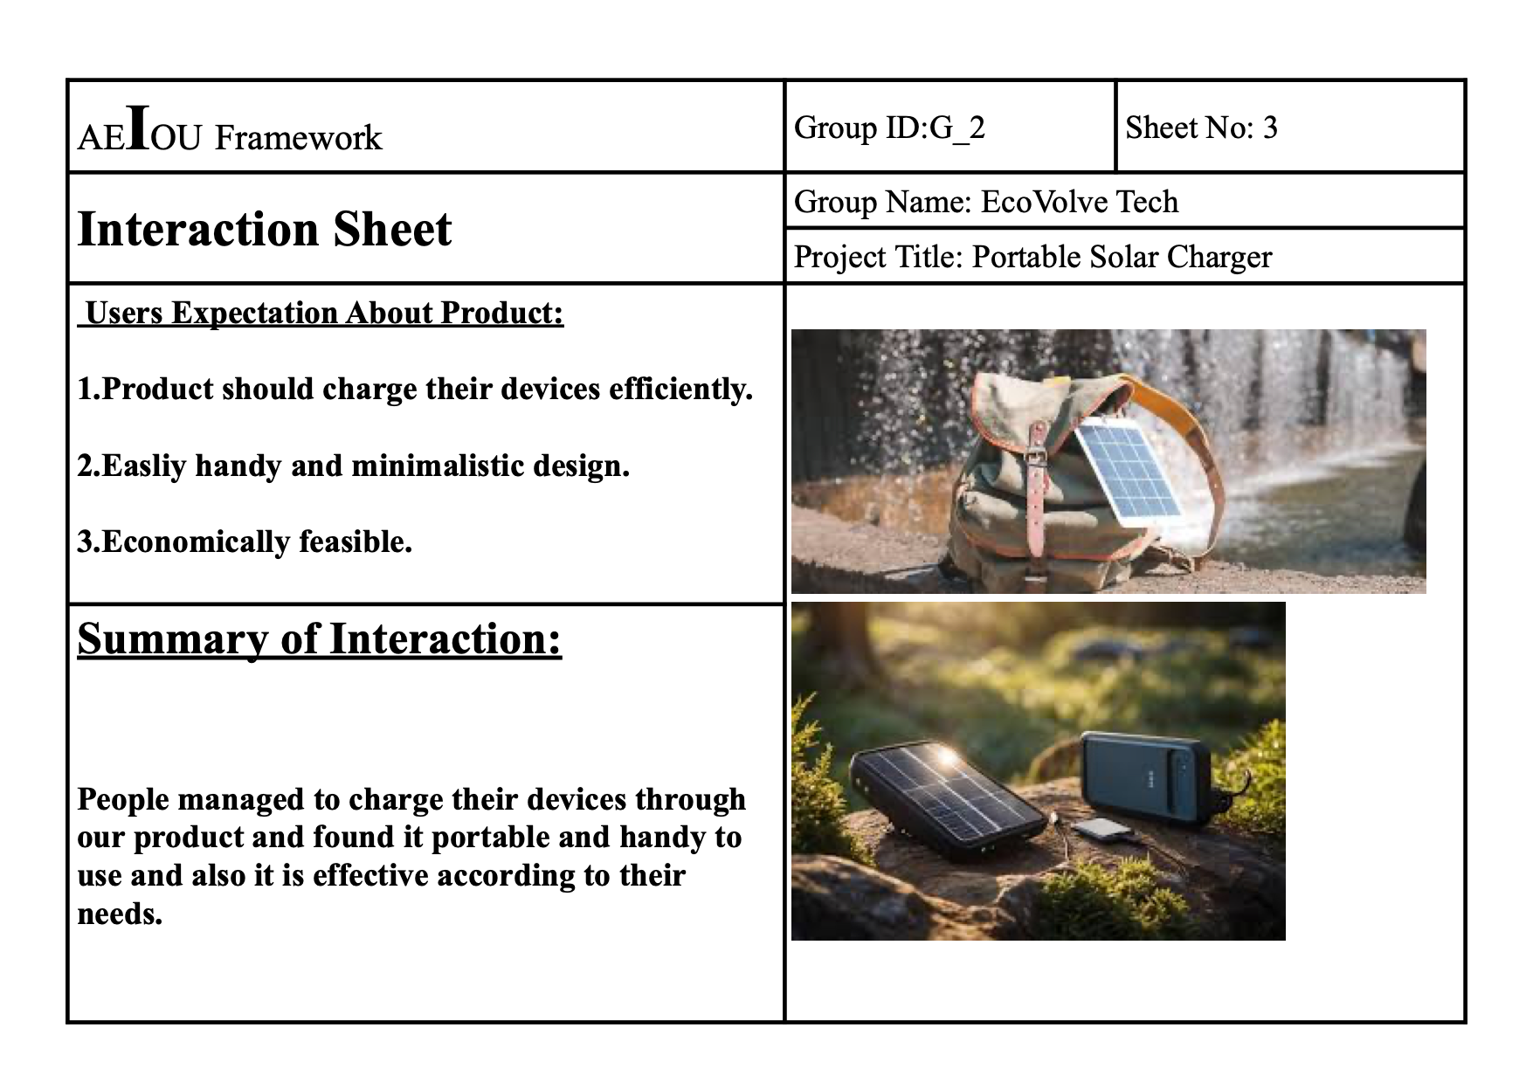
INTERACTION SHEET

Slide 16
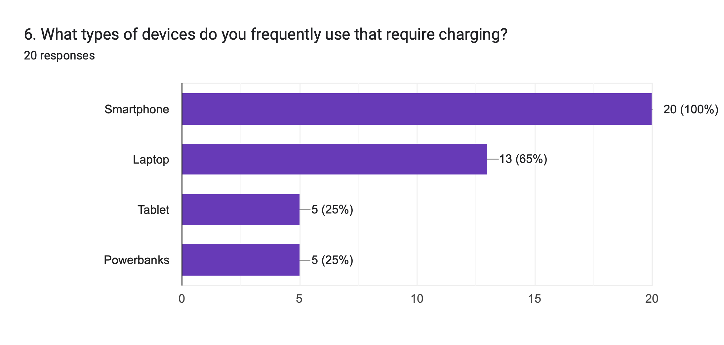
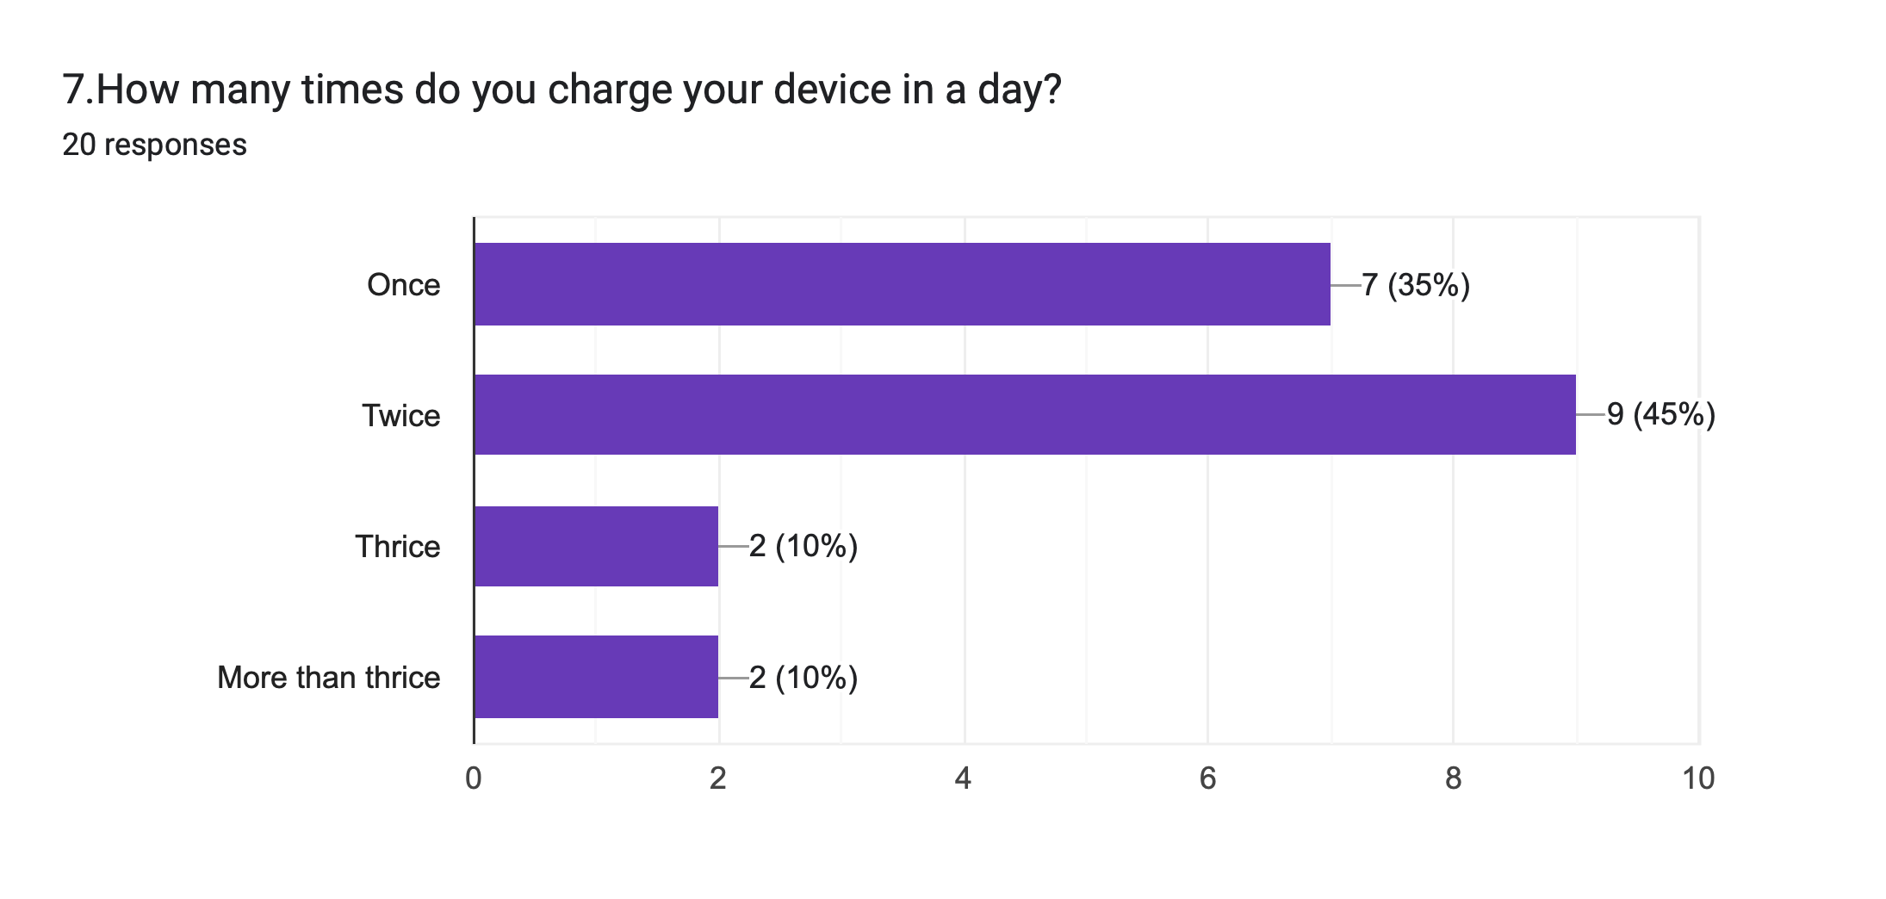
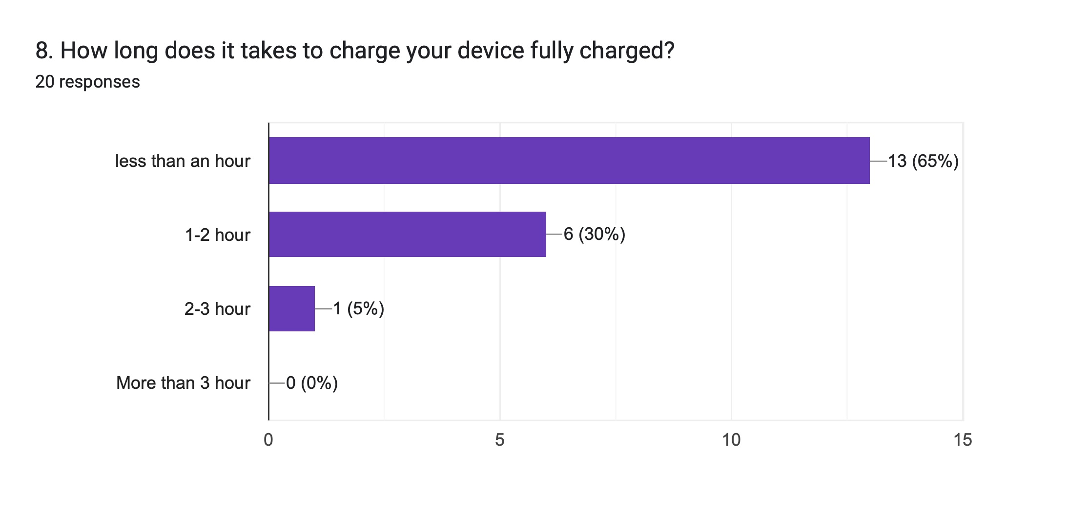
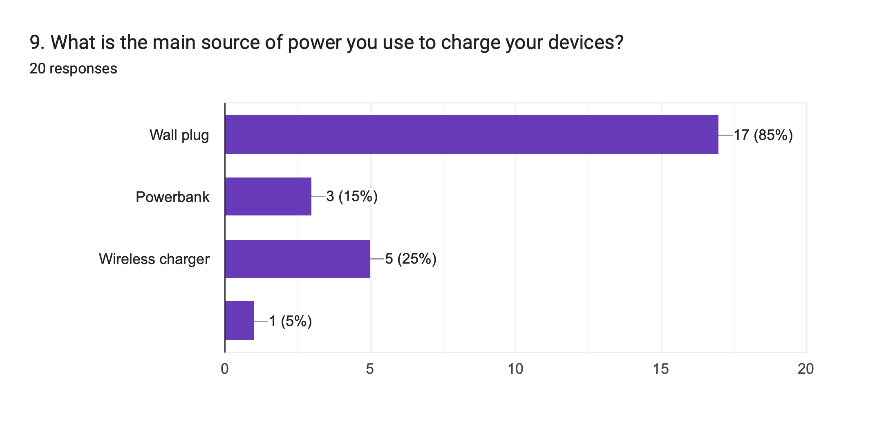
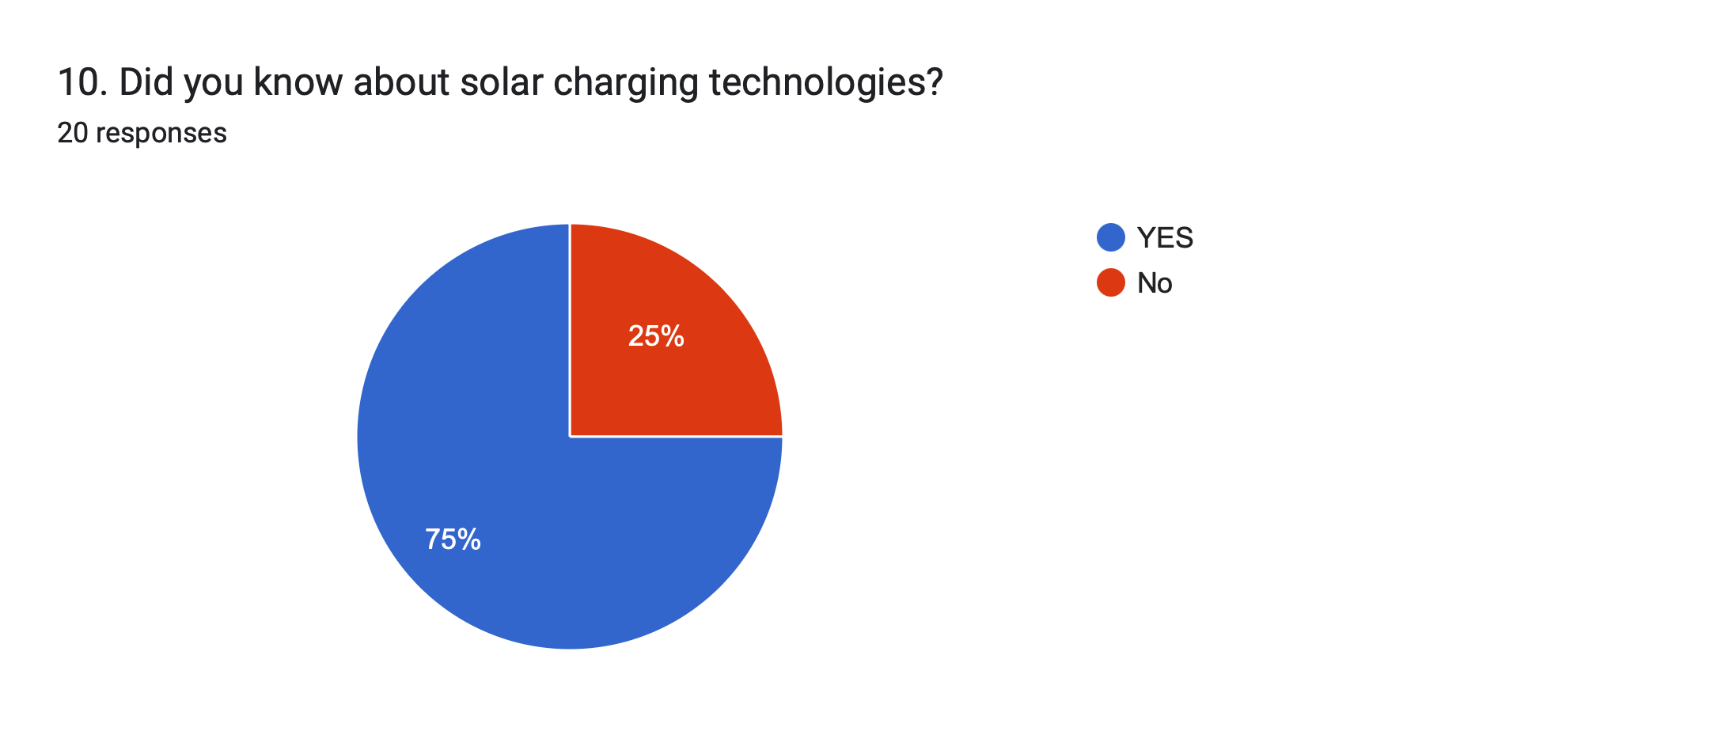
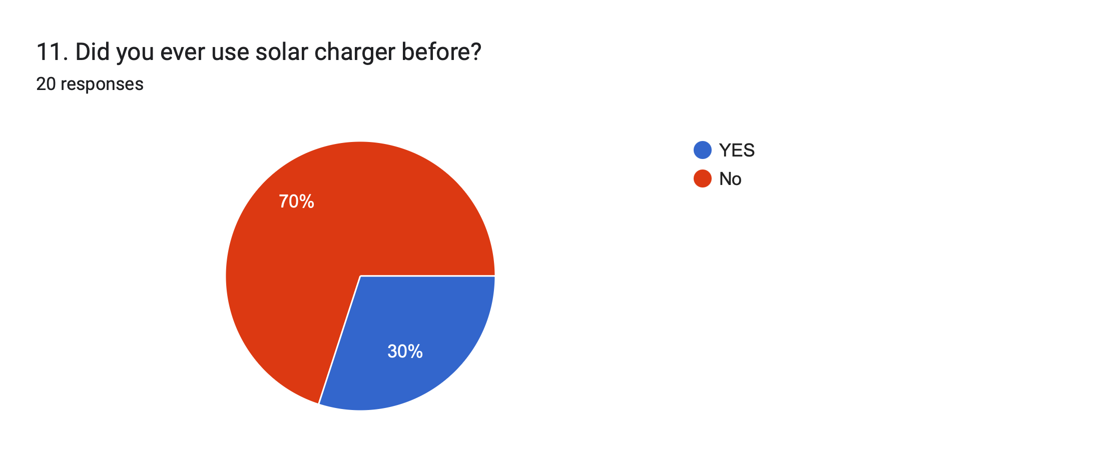
QUESTIONNAIRE
This questionnaire aims to make decision about energy
consumption, user behavior, and reason for solar charging
solution.
SECTION 1: Personal Information
1. Name:
2. Age:
3. Occupation:
4. Institution:
5. Contact:
SECTION 2: Energy Consumption and Usage
6. What types of devices do you frequently use that require
charging?
☐Smartphone
☐laptop
☐Tablet
☐Powerbanks
☐Others:___________
7. How many times do you charge your device in a day?
☐Once
☐Twice
☐Thrice
☐More than thrice
8. How long does it takes to charge your device fully charged?
☐Less than an hour
☐1-2 hour
☐2-3 hour
☐More than 3 hour
9. What is the main source of power you use to charge your
devices?
☐Wall plug
☐Power bank
☐Wireless charger
☐Other:___________
SECTION 3: Solar Power Awareness
10. Did you know about solar charging technologies?
☐YES
☐NO
11. Did you ever use solar charger before?
☐YES
☐NO

Slide 17
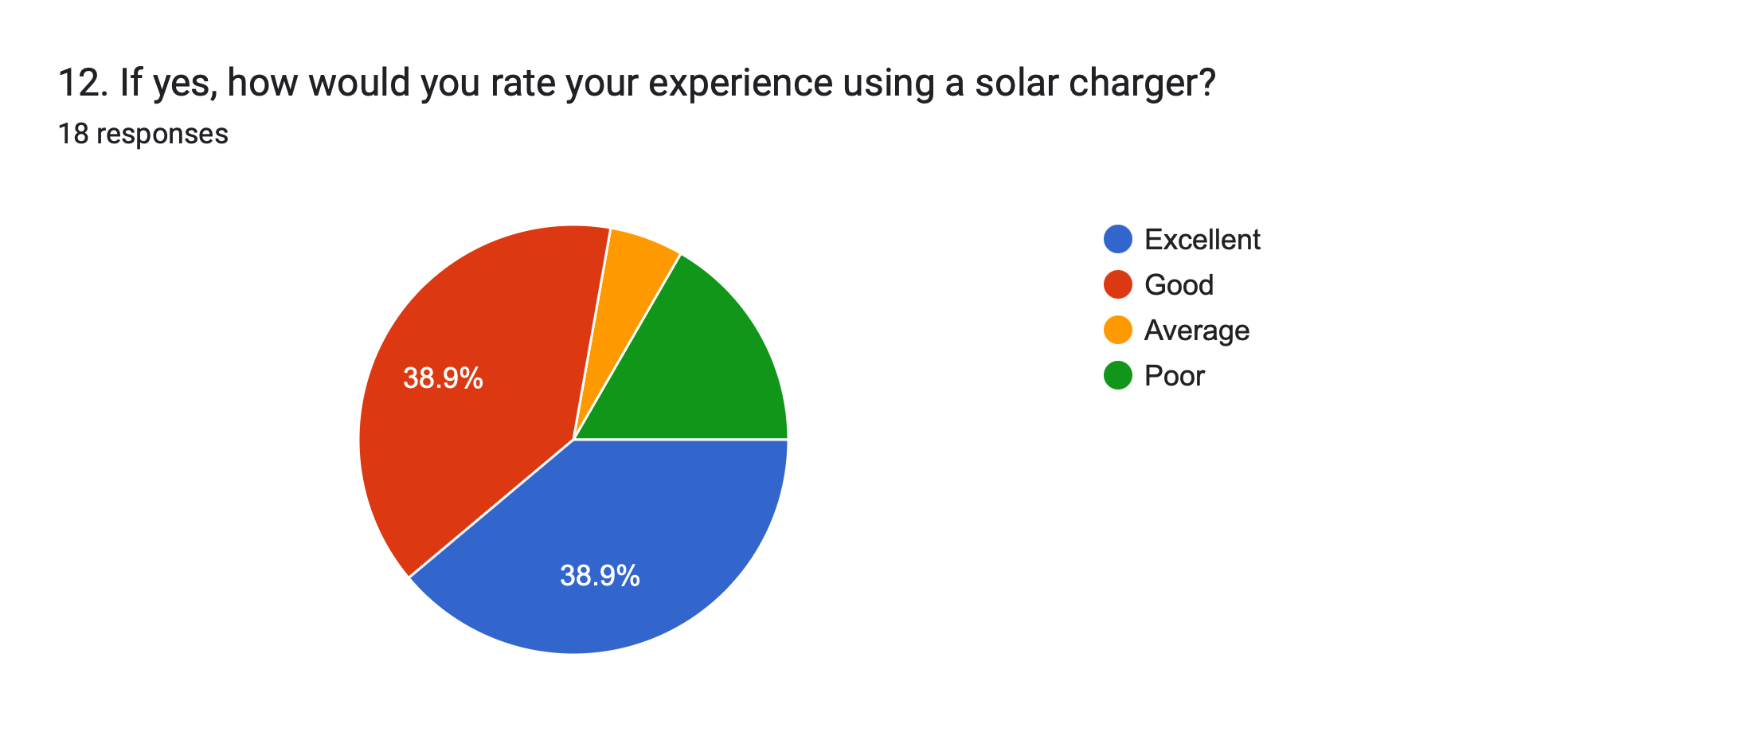
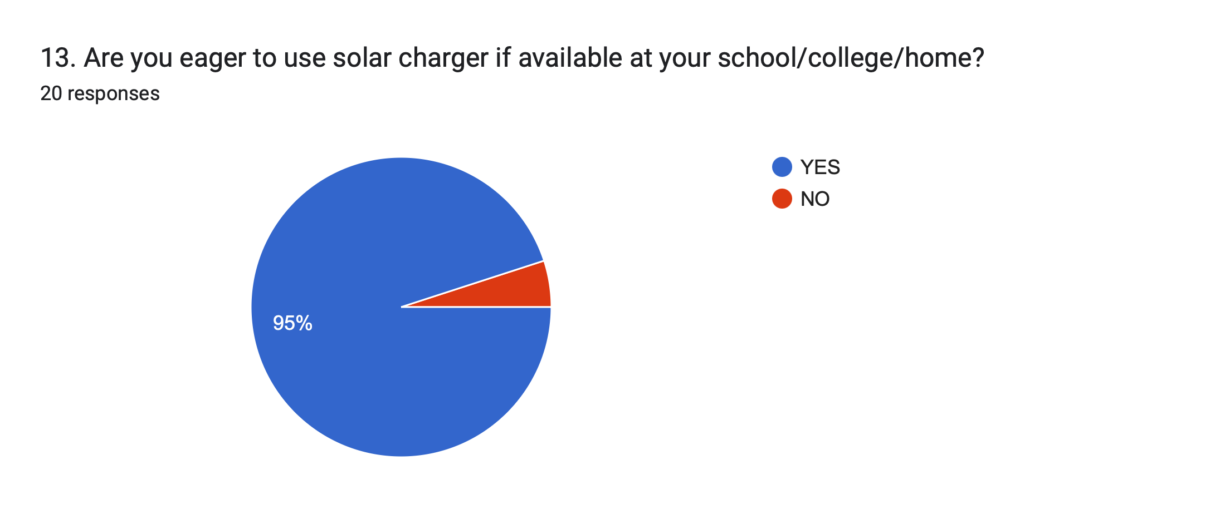
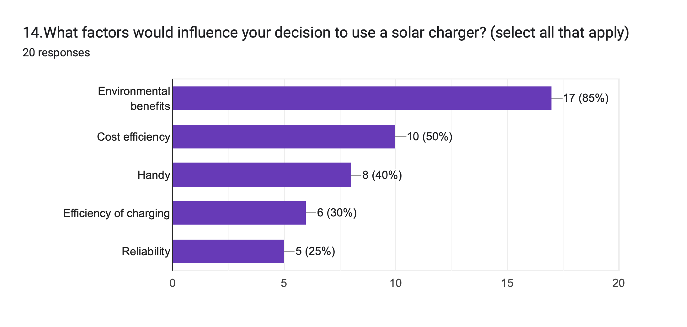
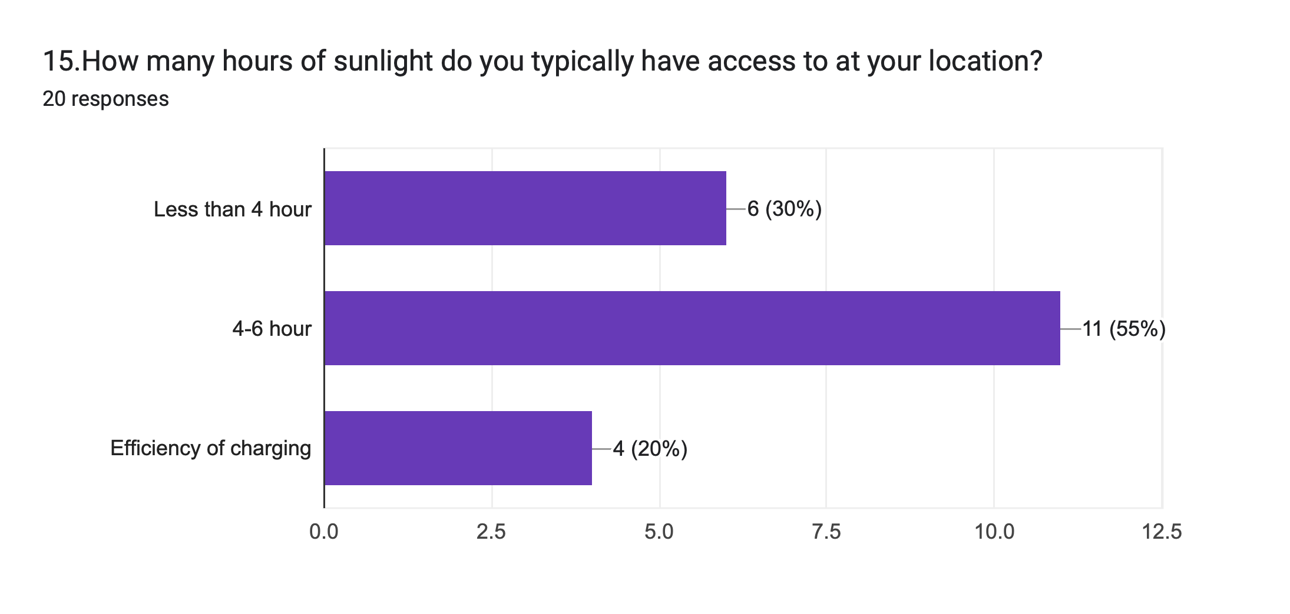
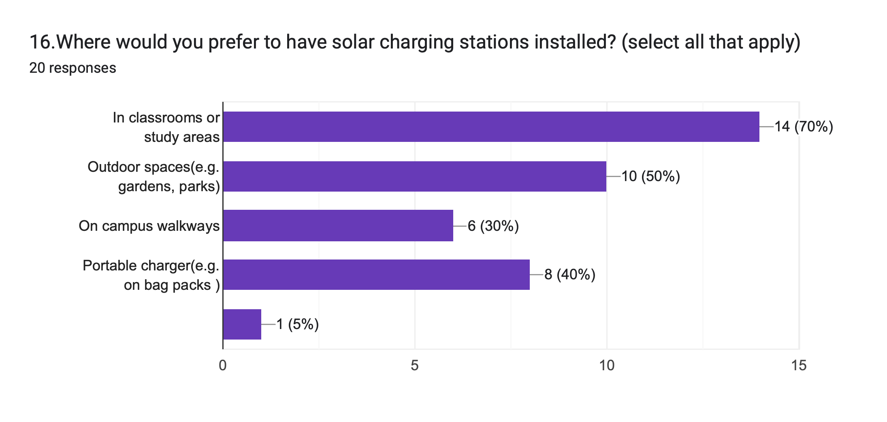
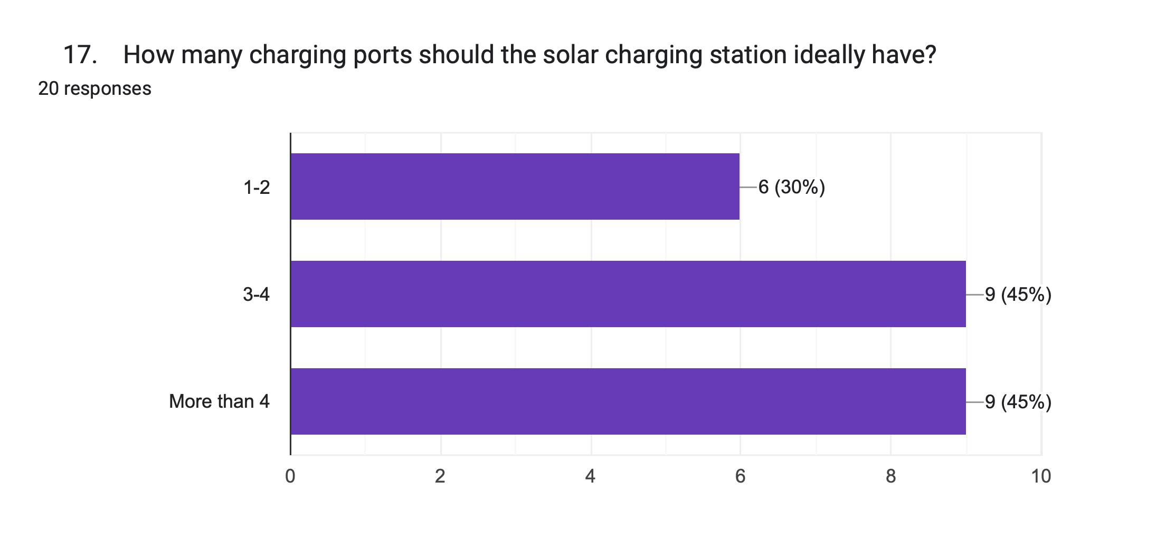
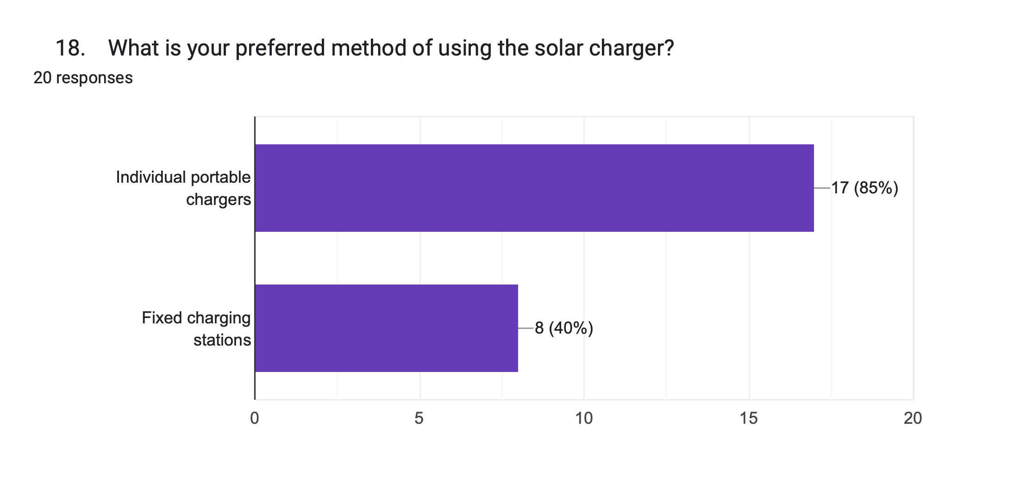
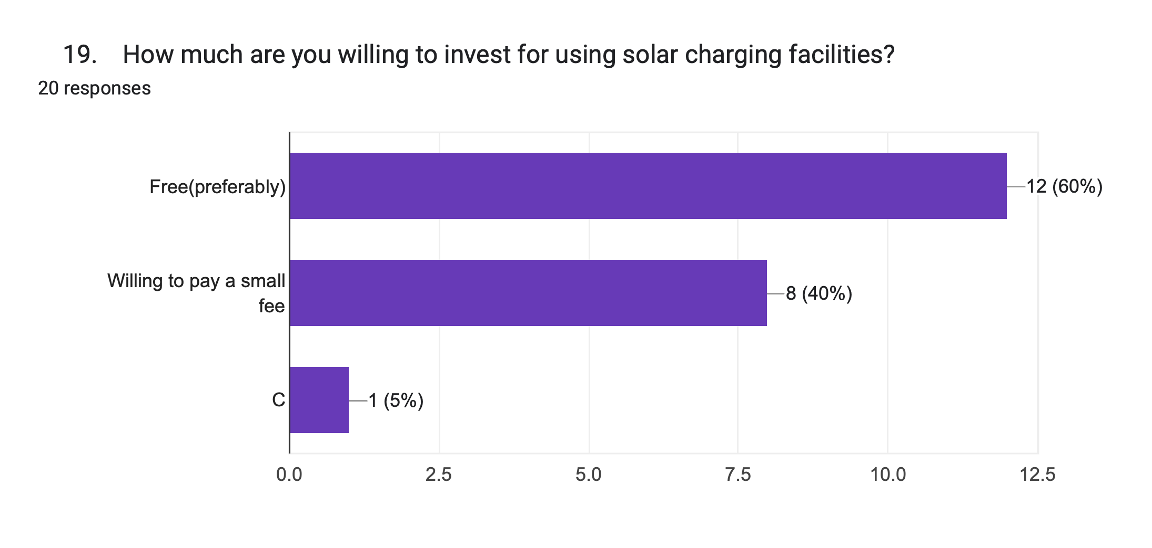
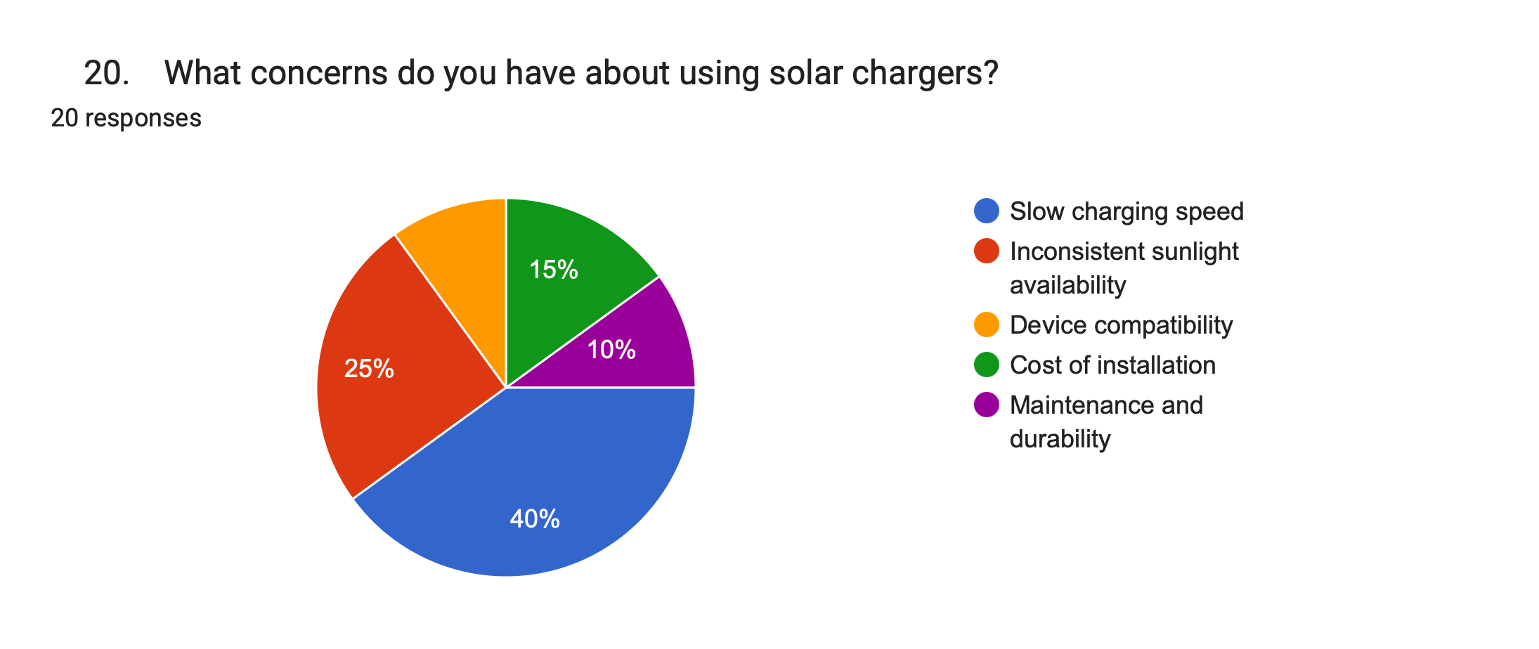
12. If yes, how would you rate your experience using a solar
charger?
☐Excellent
☐Good
☐Average
☐Poor
13. Are you eager to use solar charger if available at your
school/college/home?
☐YES
☐NO
14.What factors would influence your decision to use a solar
charger? (select all that apply)
☐Environmental benefits
☐Cost efficiency
☐Handy
☐Efficiency of charging
☐Reliability
15.How many hours of sunlight do you typically have access to
at your location?
☐Less than 4 hour
☐4-6 hour
☐More than 6 hour
SECTION 4: Technical Feasibility and Installation
16.Where would you prefer to have solar charging stations
installed? (select all that apply)
• ☐ In classrooms or study areas
• ☐ Outdoor spaces (e.g. gardens, parks)
• ☐ On campus walkways
• ☐ Portable charger (e.g. on bag pack )
• ☐ Other : __________
17. How many charging ports should the solar charging
station ideally have?
• ☐ 1-2
• ☐ 3-4
• ☐ More than 4
18. What is your preferred method of using the solar
charger?
• ☐ Individual portable chargers
• ☐ Fixed charging stations
19. How much are you willing to invest for using solar
charging facilities?
• ☐ Free (preferably)
• ☐ Willing to pay a small fee
• ☐ Other : __________
Section 5: User Concerns and Feedback
20. What concerns do you have about using solar
chargers?
• ☐ Slow charging speed
• ☐ Inconsistent sunlight availability
• ☐ Device compatibility issues
• ☐ Cost of installation
• ☐ Maintenance and durability

Slide 18
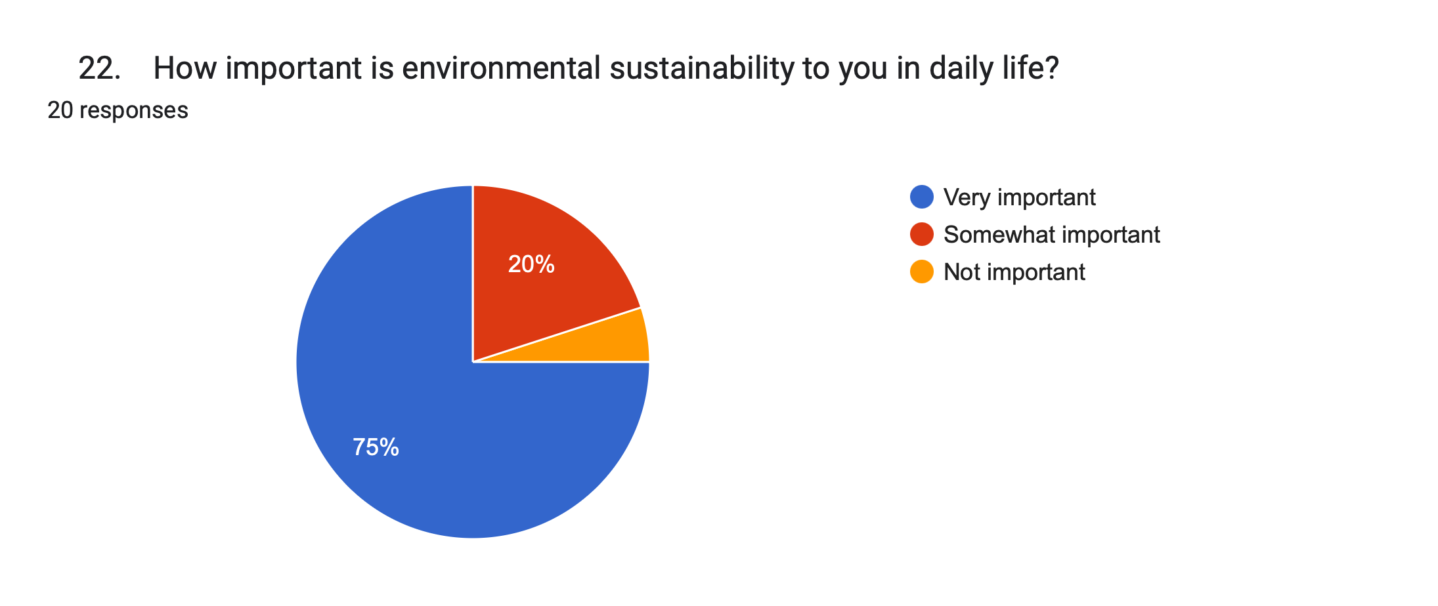
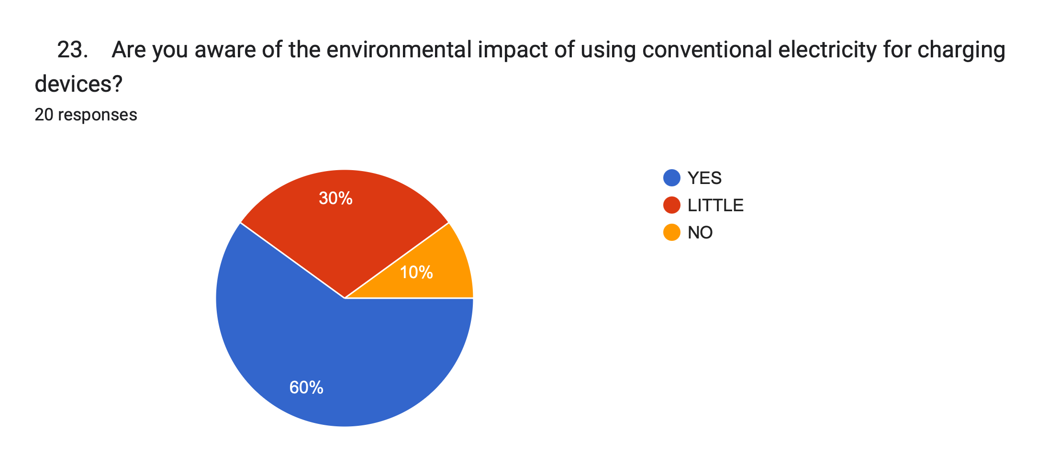
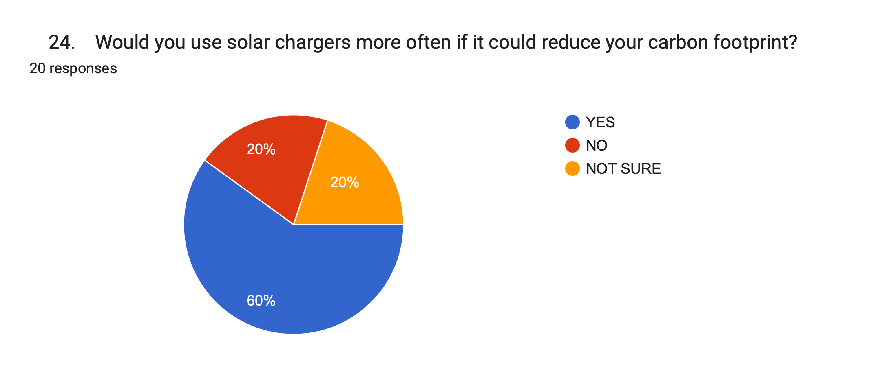
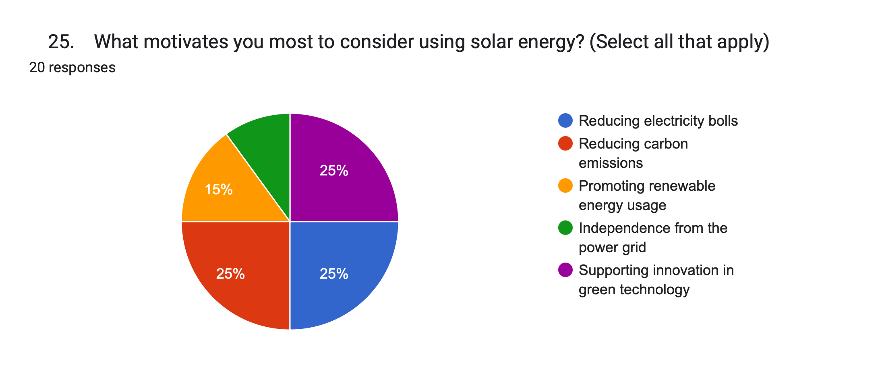
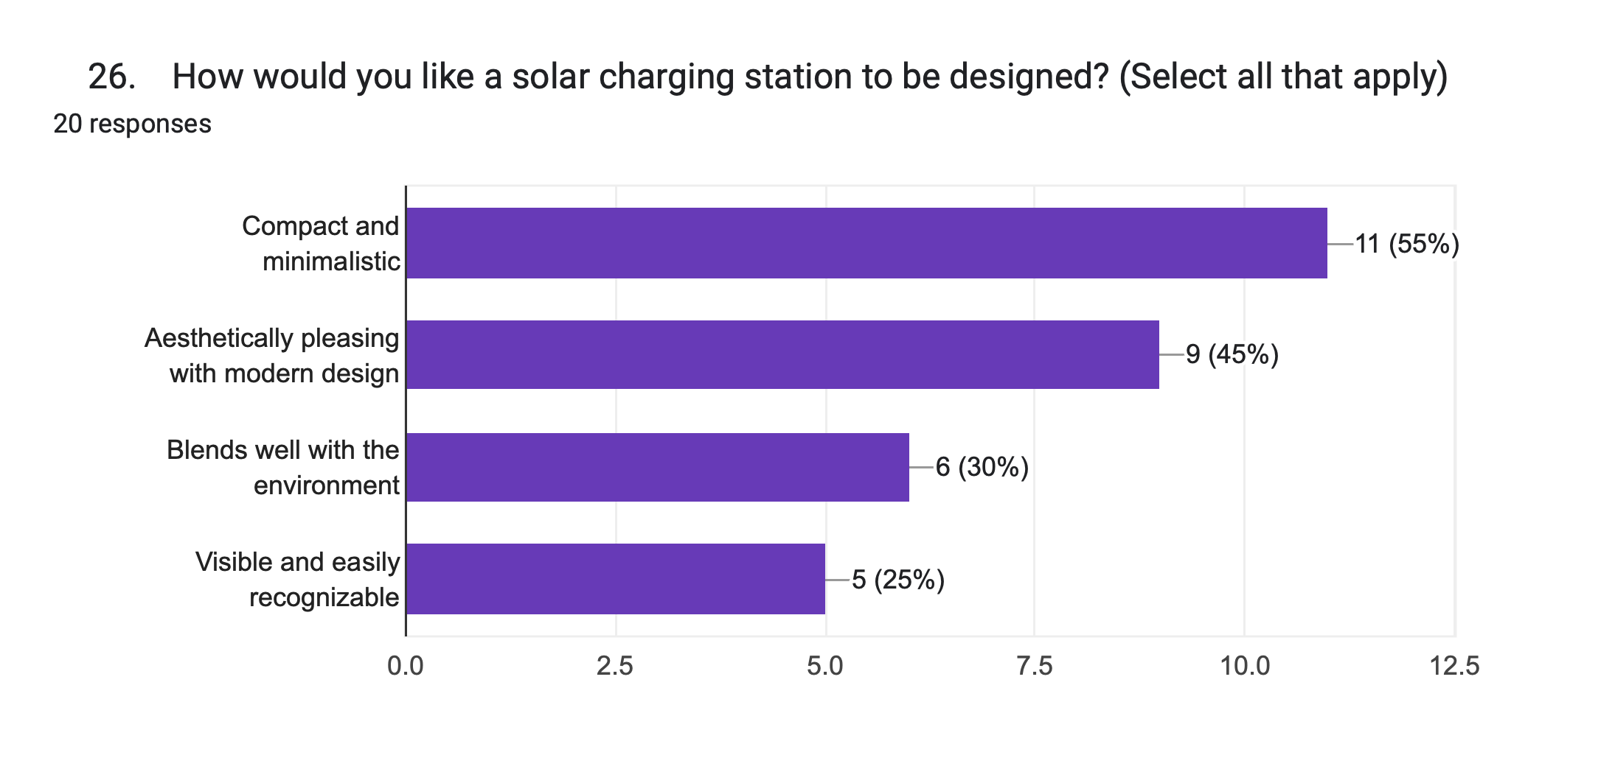
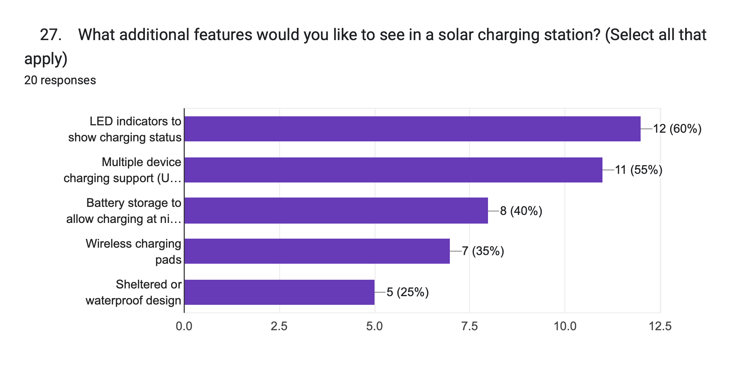
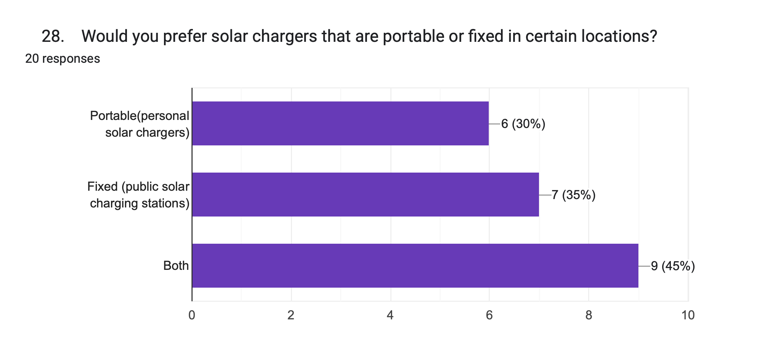
21. Do you have any suggestions or ideas for the design
or implementation of solar charging stations on campus?
Section 6: Environmental Awareness and Motivation
22. How important is environmental sustainability to you
in daily life?
• ☐ Very important
• ☐ Somewhat important
• ☐ Not important
23. Are you aware of the environmental impact of using
conventional electricity for charging devices?
• ☐ Yes
• ☐ Little
• ☐ No
24. Would you use solar chargers more often if it could
reduce your carbon footprint?
• ☐ Yes
• ☐ No
• ☐ Not sure
25. What motivates you most to consider using solar
energy? (Select all that apply)
• ☐ Reducing electricity bills
• ☐ Reducing carbon emissions
• ☐ Promoting renewable energy usage
• ☐ Independence from the power grid
• ☐ Supporting innovation in green technology
Section 7: Design Preferences
26. How would you like a solar charging station to be
designed? (Select all that apply)
• ☐ Compact and minimalistic
• ☐ Aesthetically pleasing with modern design
• ☐ Blends well with the environment
☐ Visible and easily recognizable
27. What additional features would you like to see in a
solar charging station? (Select all that apply)
• ☐ LED indicators to show charging status
• ☐ Multiple device charging support (USB, Type-C)
• ☐ Battery storage to allow charging at night
• ☐ Wireless charging pads
• ☐ Sheltered or waterproof design
28. Would you prefer solar chargers that are portable or
fixed in certain locations?
• ☐ Portable (personal solar chargers)
• ☐ Fixed (public solar charging stations)
• ☐ Both
29. Should solar charging stations offer additional
services such as Wi-Fi, seating, or a shade structure?
• ☐ Yes
• ☐ No
• ☐ Indifferent

Slide 19
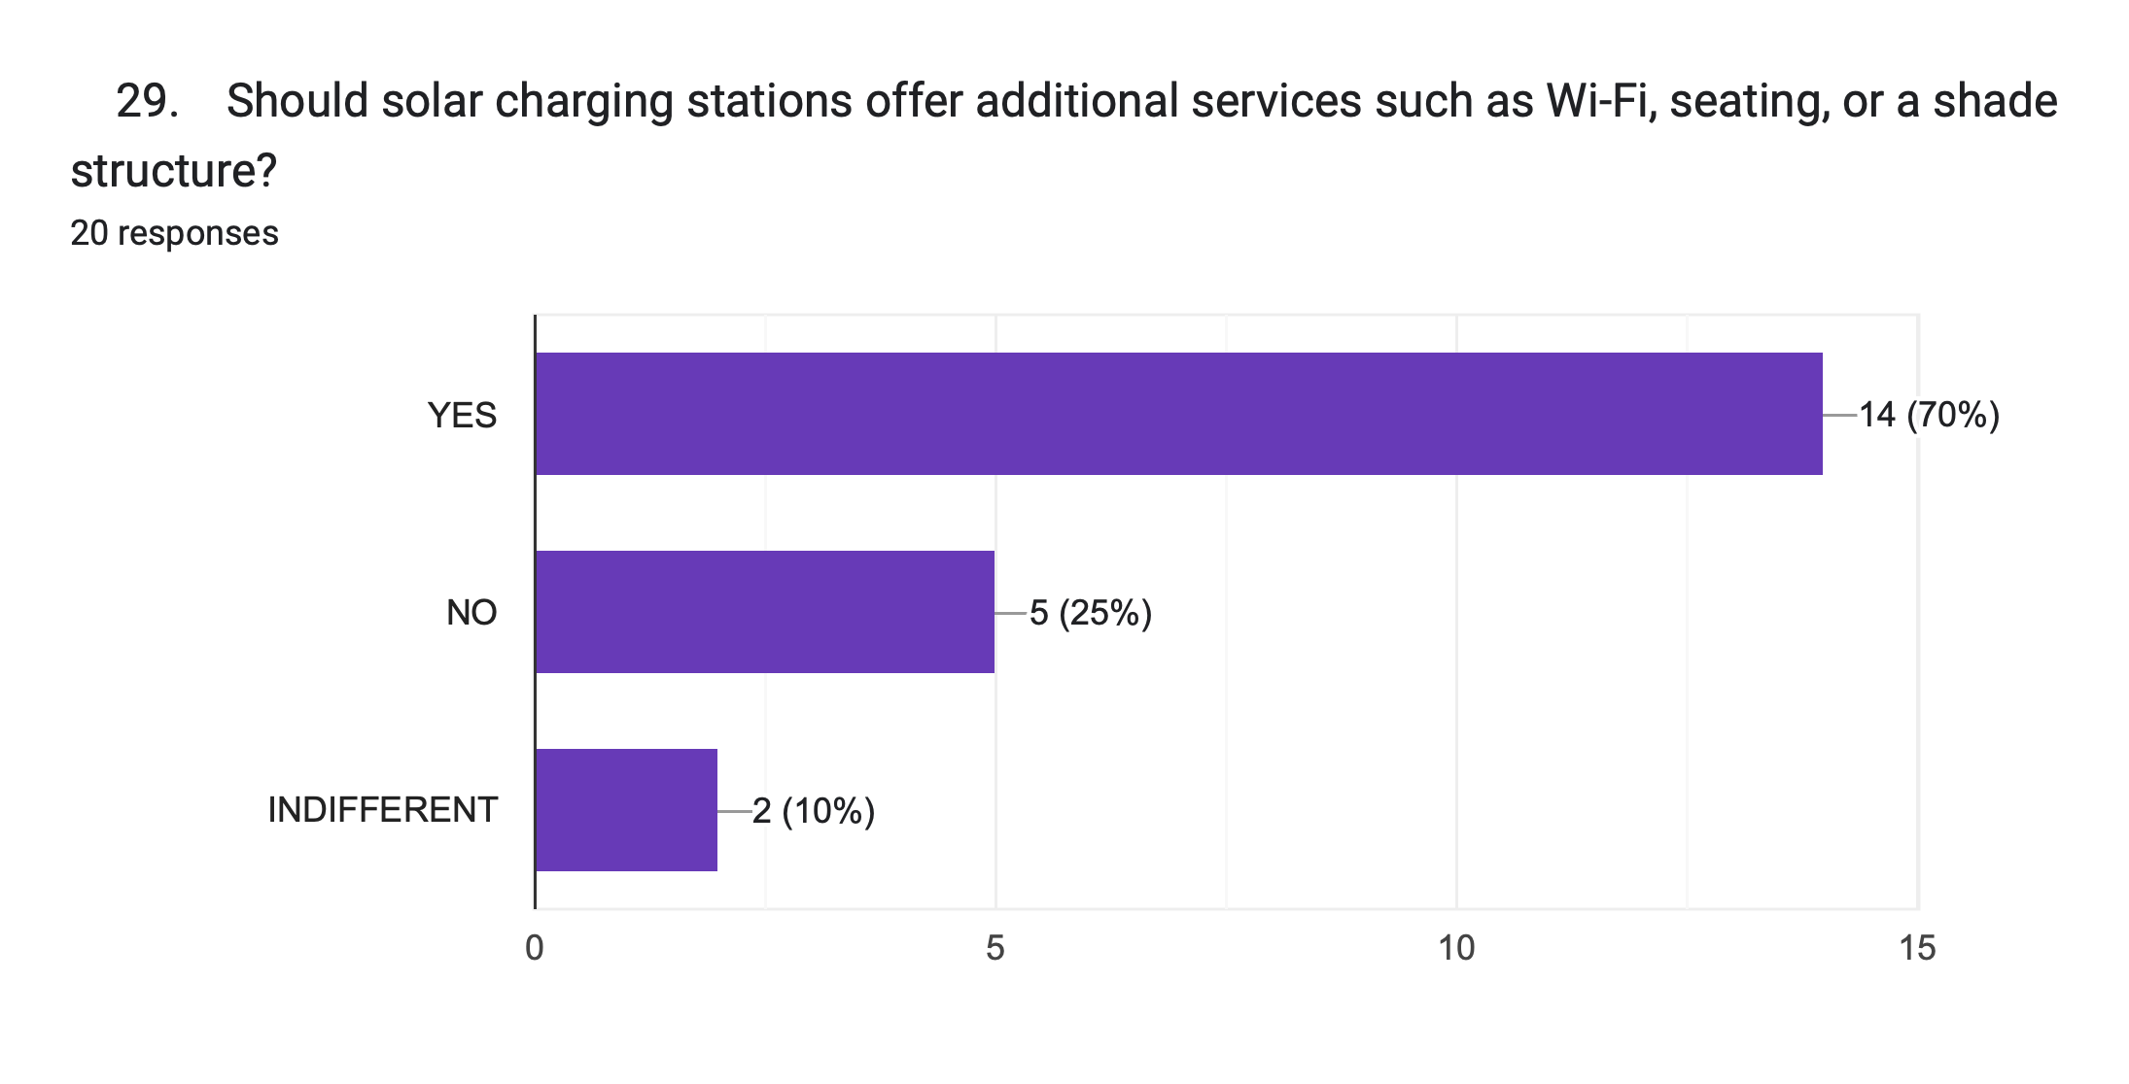
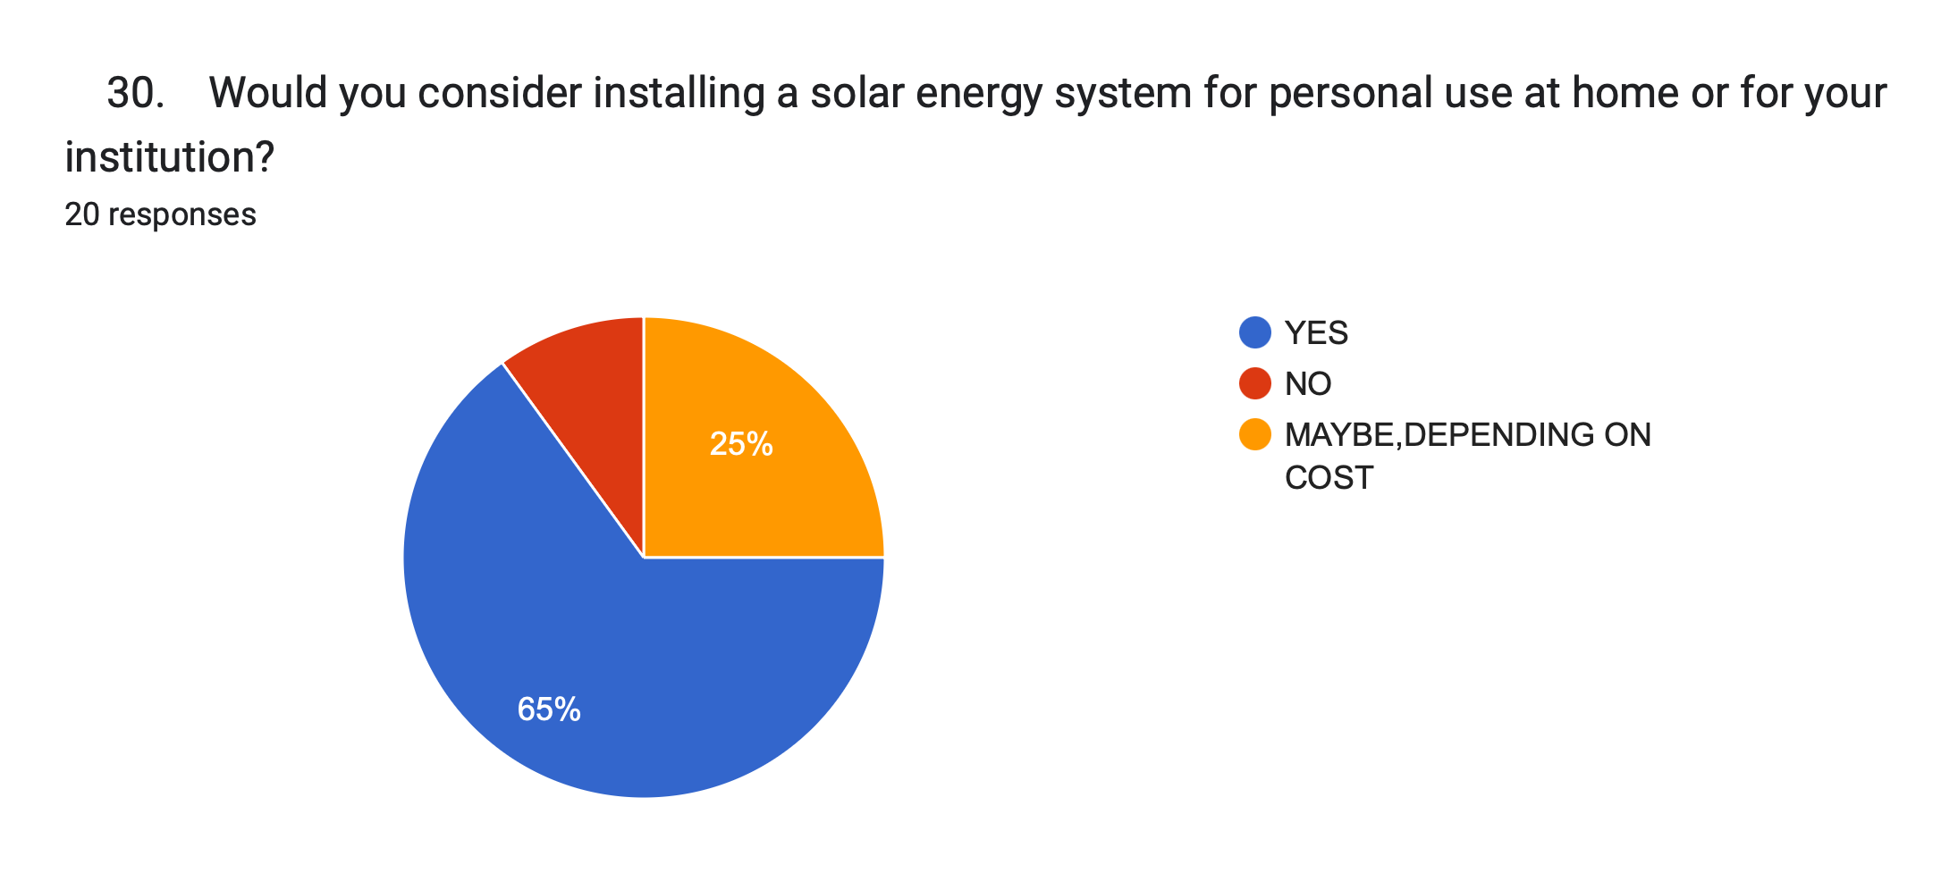
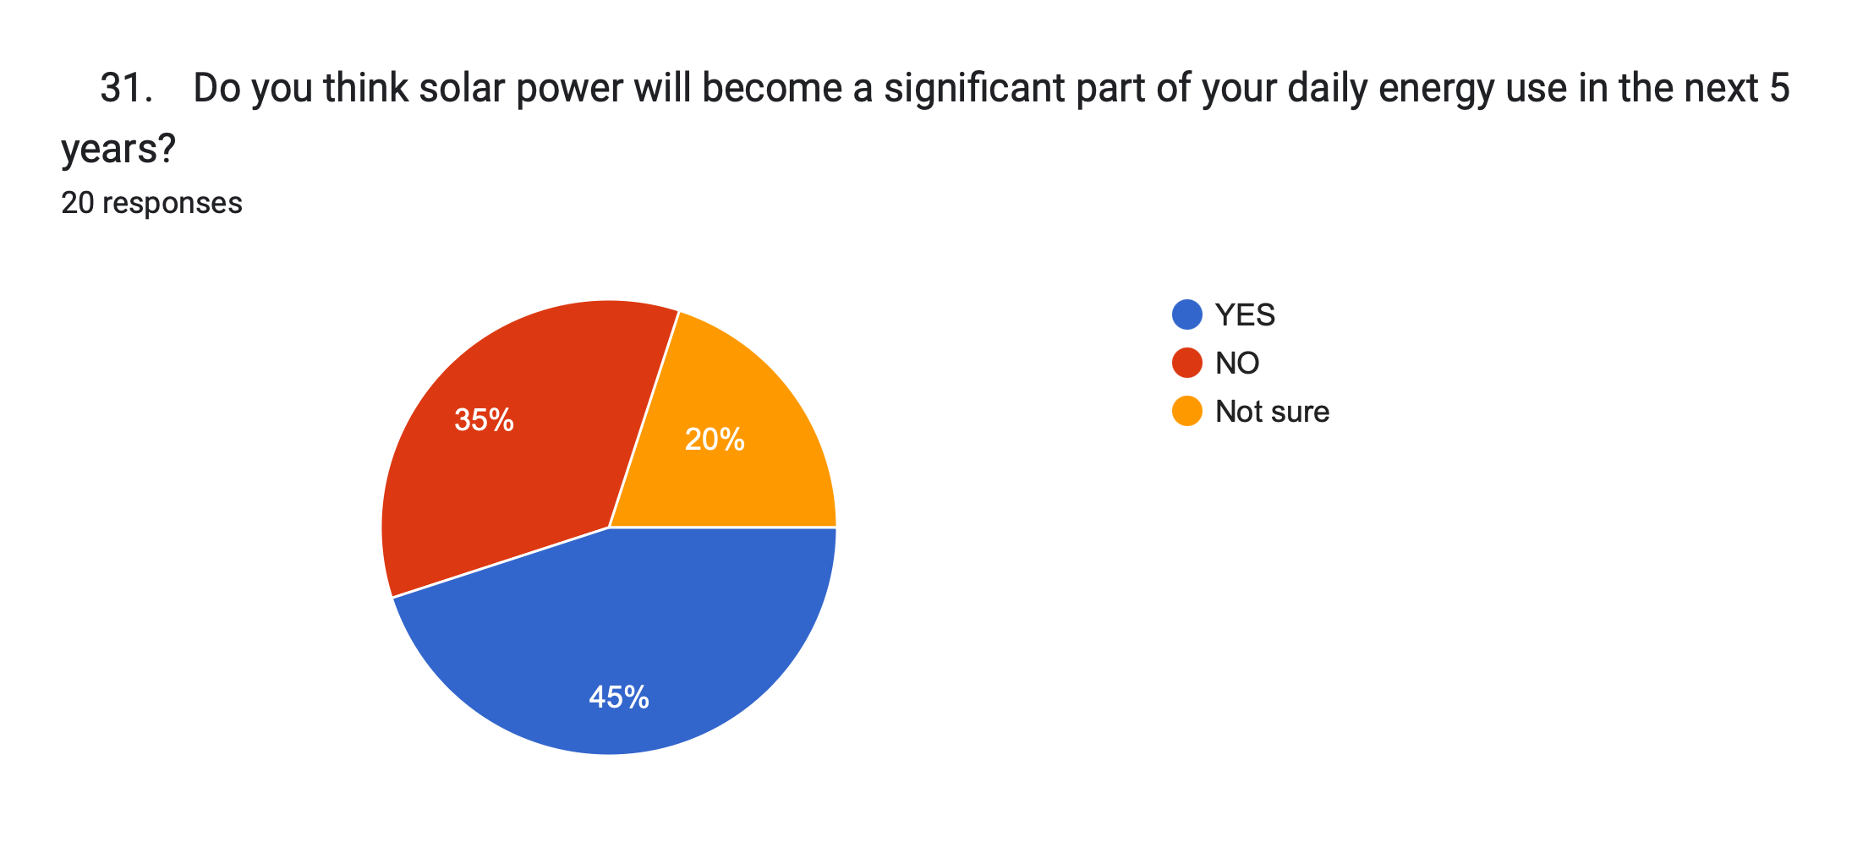
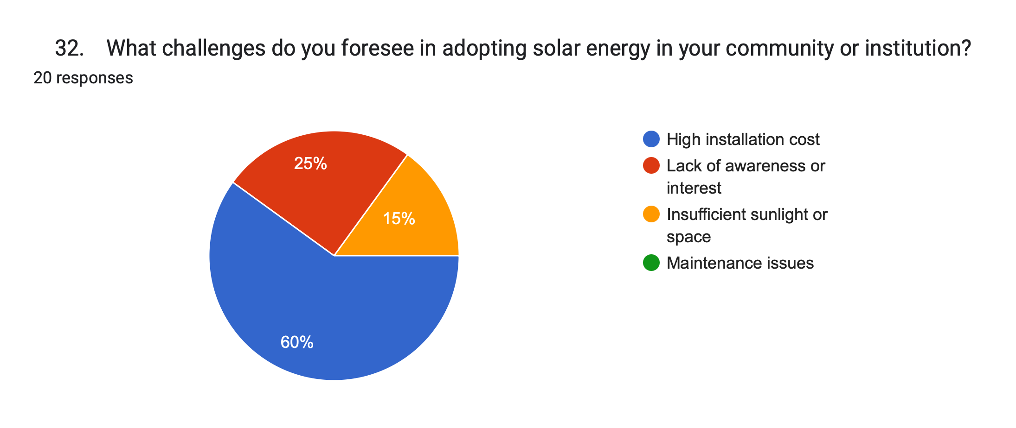
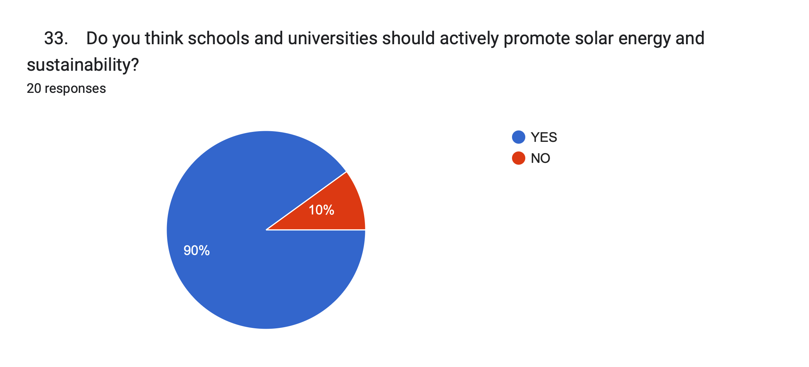
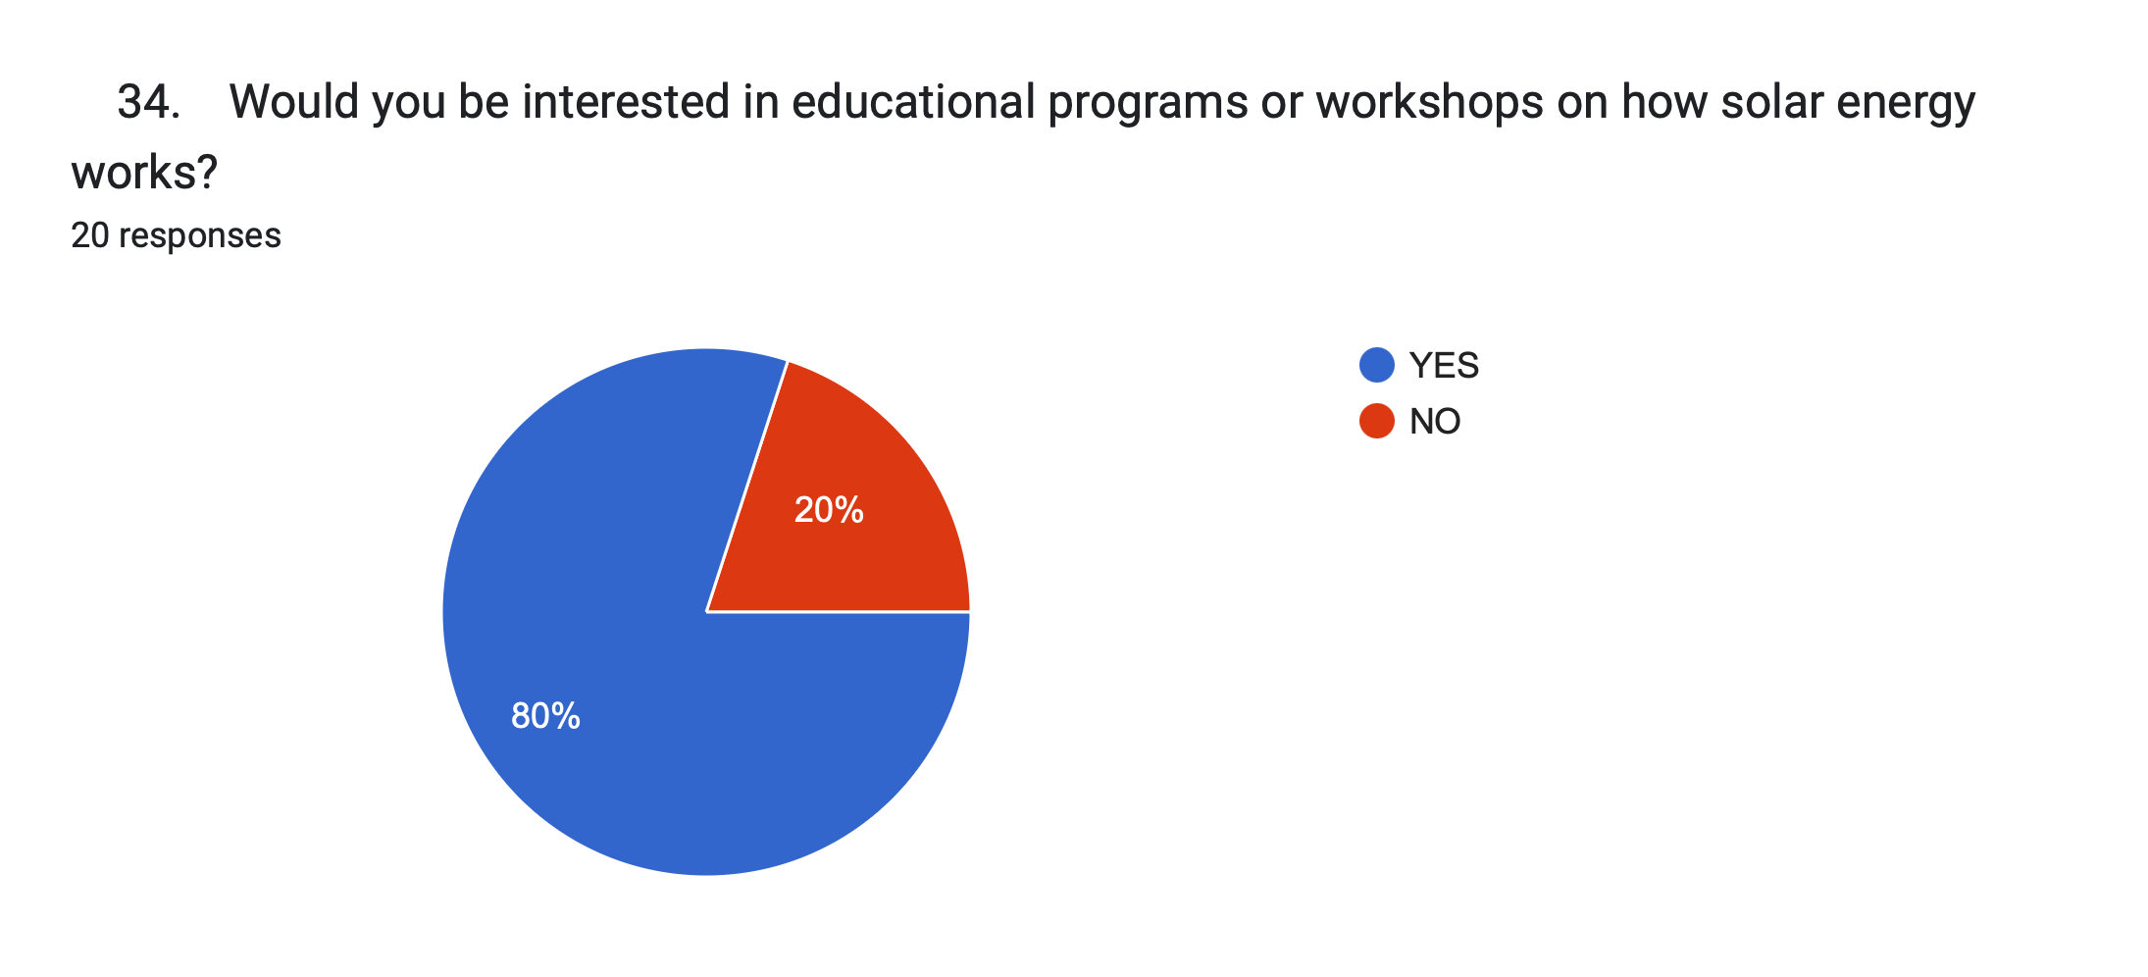
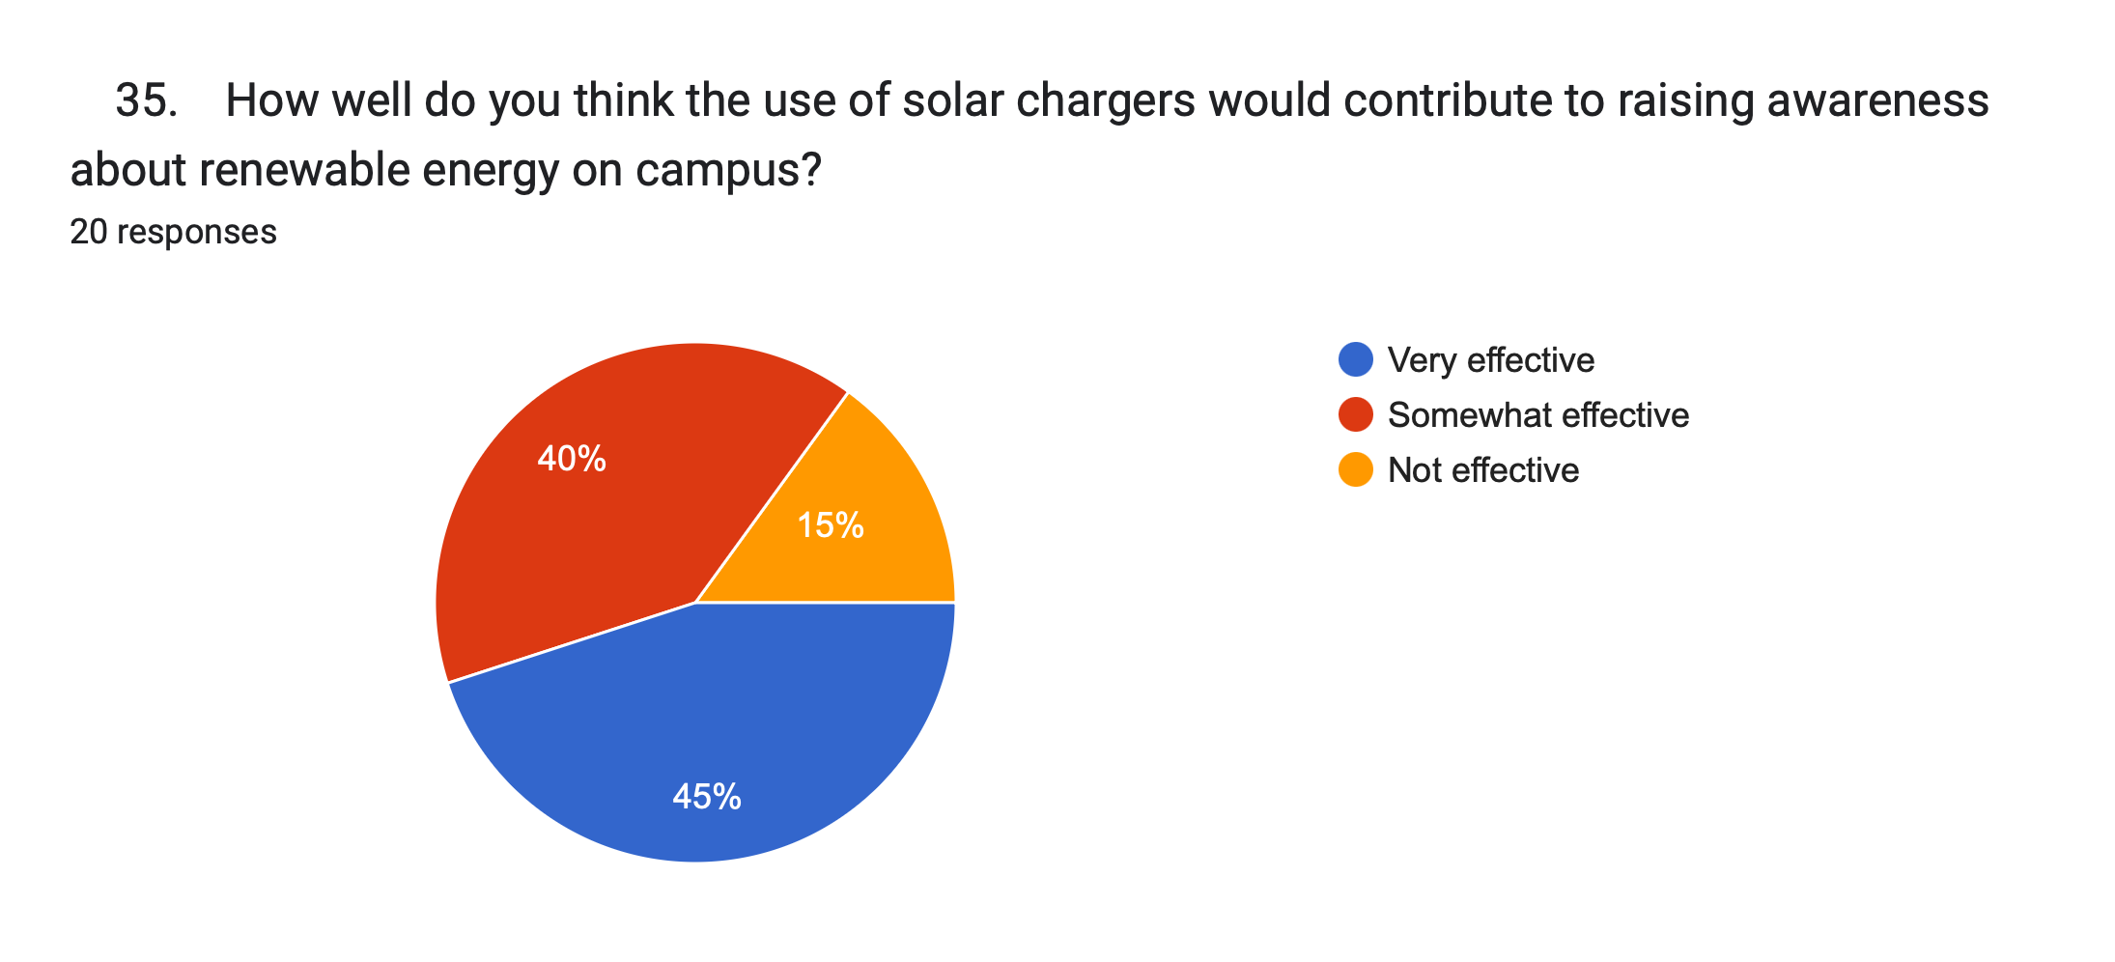
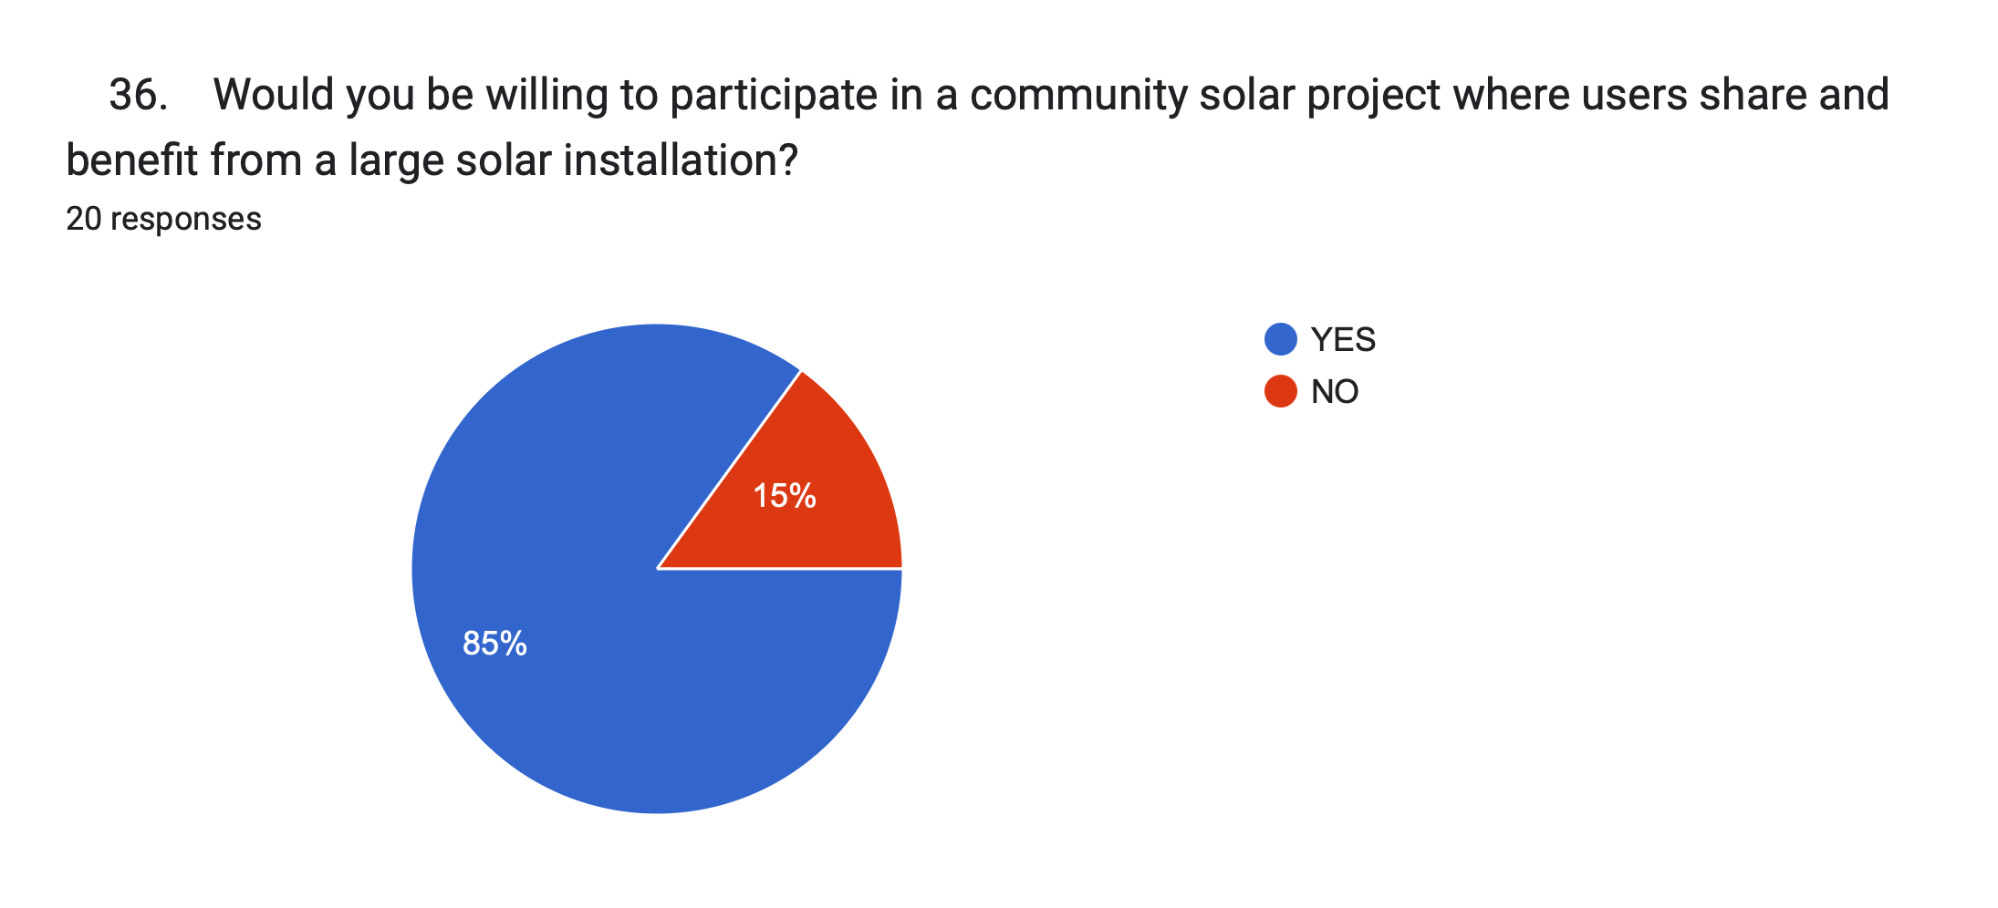
Section 8: Future Interest in Solar Energy
30. Would you consider installing a solar energy system
for personal use at home or for your institution?
• ☐ Yes
• ☐ No
• ☐ Maybe, depending on cost
31. Do you think solar power will become a significant
part of your daily energy use in the next 5 years?
• ☐ Yes
• ☐ No
• ☐ Not sure
32. What challenges do you foresee in adopting solar
energy in your community or institution?
• ☐ High installation cost
• ☐ Lack of awareness or interest
• ☐ Insufficient sunlight or space
• ☐ Maintenance issues
Section 9: Solar Energy in Education and Awareness
33. Do you think schools and universities should actively
promote solar energy and sustainability?
• ☐ Yes
• ☐ No
34. Would you be interested in educational programs or
workshops on how solar energy works?
• ☐ Yes
• ☐ No
35. How well do you think the use of solar chargers
would contribute to raising awareness about renewable
energy on campus?
• ☐ Very effective
• ☐ Somewhat effective
• ☐ Not effective
36. Would you be willing to participate in a community
solar project where users share and benefit from a large solar
installation?
• ☐ Yes
• ☐ No

Slide 20
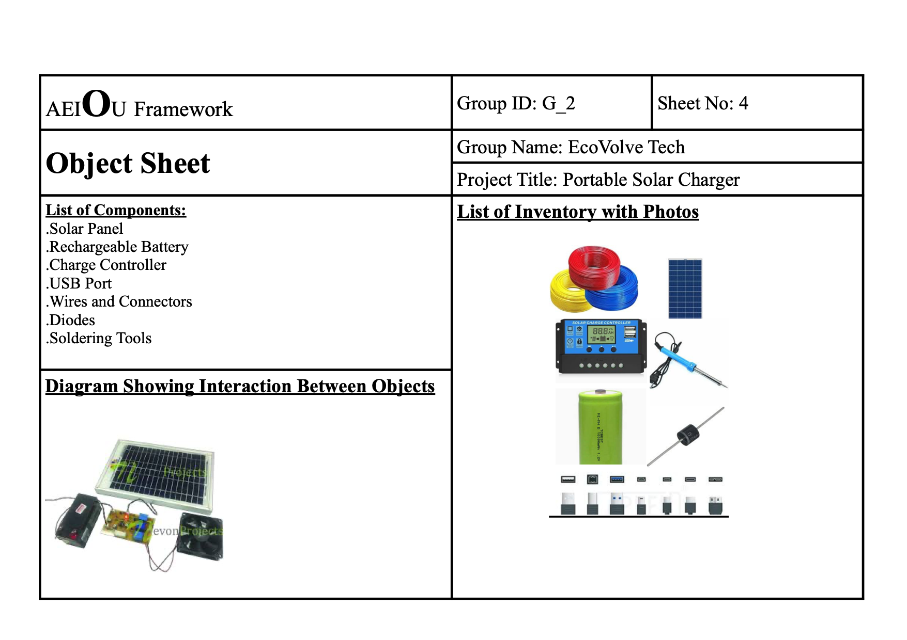
OBJECT SHEET

Slide 21
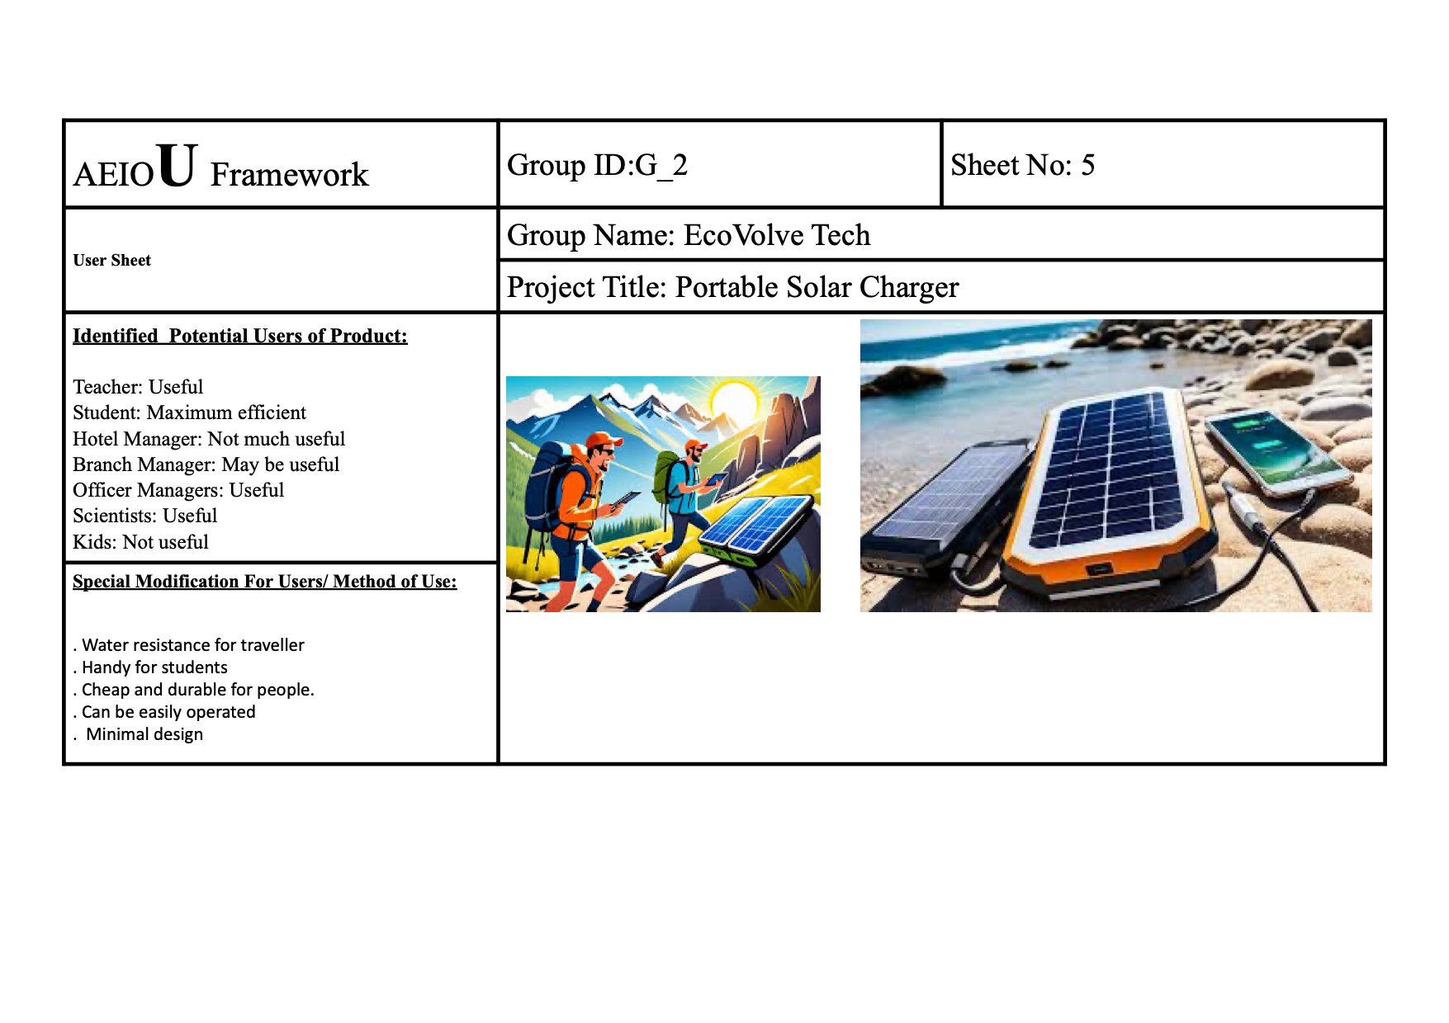
USER SHEET

Slide 22
Empathy Mapping | Group ID: G2 | Sheet No: 6
Group Name:Team EchoVolve | Project Title: Portable solar charger
HEARS Solar charger are bulky to carry: There is a misconception that solar charger are heavy and big in size. Solar charger are slow: Some says that solar charger is slow ,which is somewhat true. Solar charger are not good in looks: Solar charger are boring looking because of their plates. Its not trusted: Some people says that it damages battery. | USERS: Students Travellers Hikers Common peoples
THINK: Who will use the charger? Decide the size and portability? Select battery size and panel storage? DO: Measure the time to charge the device. Check the portability for student and traveller. Distribute the charger to a group to test it among potential users . | SEE: A lightweight, foldable solar panel that fits easily into a backpack. Witness the charger collecting sunlight and converting it into usable energy. Experience the charger working outdoors( eg.moderate sunlight). FEEL: Experience the satisfaction of contributing to a sustainable future. Enjoy seamless charging on the go, eliminating the hassle of dead devices. Feel inspired to explore and innovate further in clean energy solutions.
Sad Story: In a village, Maria lived without electricity, relying on dim kerosene lamps to study at night. One day, a charity gifted her a solar portable charger, transforming her evenings. She charged it daily under the sun, powering a small LED lamp that lit her desk. For weeks, Maria’s dreams of becoming a doctor felt within reach.But one evening, the charger stopped working. Despite hours in the sun, it wouldn’t charge. Upon inspection, she discovered a melted wire—the harsh sun and poor-quality materials had damaged it. With no means to repair or replace it, Maria returned to studying by the flickering kerosene lamp.The broken charger, once a beacon of hope, became a symbol of fleeting opportunity. Though disheartened, Maria’s determination endured, a reminder that innovative solutions must be durable to truly empower those who depend on them.

Slide 23
Happy Story: In a village without electricity, Aryan dreamed of becoming an engineer. Nights were challenging, as studying by the dim light of a kerosene lamp hurt his eyes. One day, a community worker gifted him a solar portable charger with a small LED lamp.Excited, Aryan placed the charger in the sun every morning, ensuring it soaked up as much energy as possible. By evening, his small desk was brightly lit, and he could study for hours without strain. The charger even powered his mother’s phone, allowing her to stay connected with relatives for the first time in years.The solar charger became a cornerstone of their lives, bringing light and hope. Aryan aced his exams that year and began teaching younger kids in the village under the bright glow of his LED lamp. The little charger didn’t just provide energy—it ignited dreams.

Slide 24
Ideation Canvas Group ID:G-2 Sheet No: 7
Group Name: TEAM ECOVOLVE Project Title: PORTABLE SOLAR CHARGER.
PEOPLE
MAINLY STUDENTS ,TRAVELLER , COMMON PEOPLE.
ACTIVITIES
. Field work.
. Solar plates checking.
. Portability checking.
. Eﬃciency.
. People opinions.
SITUATION/CONTEXT/LOCATION
* Location: open ground, roads ,treks
* Situation : At time of low power on electronic devices.
* Context : Some times our mobile phones are dead on the way to
somewhere so ,if we have solar portable charger we can
Charge our devices on the way going.
PROPS/POSSIBLE SOLUTIONS
* Power banks
* Some power stations
* portable charger on bags
* solar power bricks
* Solar powered jackets

Slide 25
SUMMARY OF HOW TEAM MEMBERS MAKE THE IDEATION PROCESS
As part of the team working on the solar portable power charger, the ideation process was an exciting and collaborative journey. It all started during one of our brainstorming sessions when we identified the growing need for portable, eco-friendly energy solutions. I suggested focusing on solar energy since it’s sustainable and widely available, which resonated with the team.
We began mapping out the challenges people face with existing chargers, like bulkiness or reliance on electricity. I remember conducting interviews with potential users, which helped us understand that durability and lightweight design were key priorities. With this in mind, we sketched out initial concepts, and I contributed ideas for integrating flexible solar panels to keep it compact.
The discussions got lively as we debated battery types and charging capacities. It felt rewarding to see how each team member brought their expertise to the table—someone proposed using recyclable materials for the casing, and I pitched in with a design that could work efficiently even in low-light conditions. By the end of the process, we had a clear vision of creating something both practical and environmentally responsible. It felt amazing to be part of a team driven by innovation and purpose.

Slide 26
Product Development Canvas |  | Group ID:2 |  | Sheet No:8
Group Name: EcoVolve Tech |  | Project Title: Portable Solar Charger
Sustainable Energy Solution Portability for Off-Grid Use Emergency Power Cost Savings Environmentally Friendly Support for Remote Areas | Solar Panels Charge Controller Battery (Optional in Some Designs) Inverter Output Ports and Connectors Cables and Wiring |  | Subject: We Value Your Feedback! Dear [Customer's Name], Thank you for choosing our portable solar charger! We’d love to hear how it’s working for you. Are you finding it helpful, and is there anything we can improve? Your feedback helps us enhance our products and service. Share your thoughts or leave a quick review [here: link]. Need support? Contact us anytime at [email/phone]. Thank you for powering with us! Warm regards, [Your Name] [Your Company Name]
 | Panels can be folded into a compact form for easy transport. Panels are often made with scratch-resistant and water-resistant materials. Up to 25% efficiency in direct sunlight. built with recyclable components.
 |  |  | 1. Proven Efficiency: The current design meets energy generation and storage requirements effectively, ensuring its practicality. 2. Reliability: Existing design components have been tested under varying conditions, demonstrating consistent performance. 3. Scalability: The design supports future enhancements, such as increased storage capacity or advanced solar panels. 4. Cost-Effectiveness: Redesigning may lead to unnecessary expenditure on research, development, and prototyping. 5. Resource Utilization: Retaining the current design maximizes the return on investment in existing materials and resources. 6. Maintenance Economy: The design allows for cost-efficient maintenance, minimizing long-term financial burden. 7. Time-Saving: Redesigning could delay implementation, postponing the benefits of solar charging solutions. 8. Deadline Constraints: Retaining the design ensures the project stays on schedule and meets pre-set milestones.
1. Camping, hiking, or other outdoor activities. 2. Emergency preparedness and disaster relief. 3. Remote work or travel in areas without reliable power.
 | "The TechEvolve Portable charger was a lifesaver on my camping trip! Its foldable design made it easy to carry, and the solar panels charged my phone and power bank efficiently, even on cloudy days. I appreciated the multiple USB ports for charging several devices at once. The charger is durable and perfect for outdoor adventures. Highly recommend it for anyone needing reliable power on the go!"

Slide 27
CONTRIBUTION BY EACH MEMBERS
SHUBH: Technical work
RISHI: Material work
MADINA: Research work
SINDHUJA: Research work

Slide 28
THANK YOU
~TEAM ECOVOLVE

